Slide 1
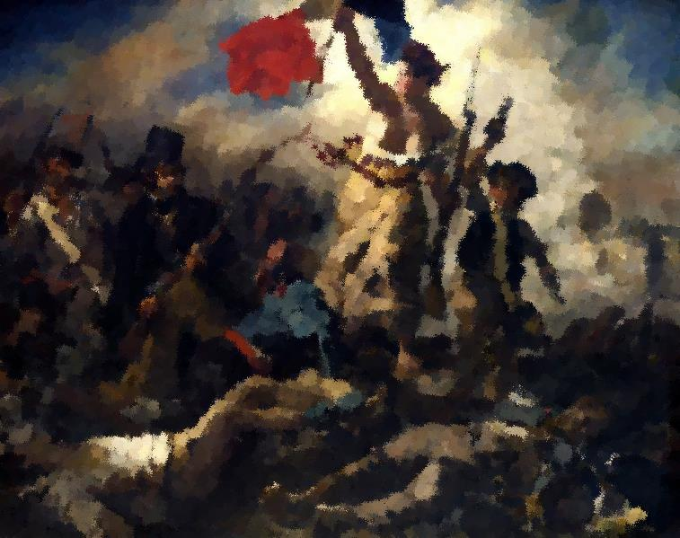
Liberalism and Revolution
By Devika Chandramohan
Period 5- Kinberg
January 12, 2013

Slide 2
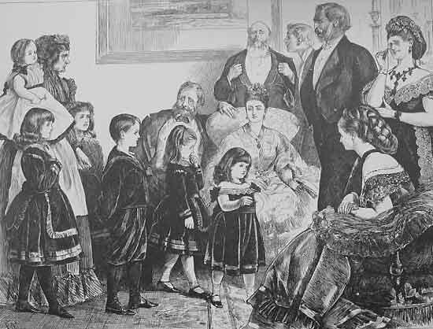
Liberalism
A set of attitudes
Revolved around social progress, economic development
Mainly promoted by the middle class (very stable and powerful class)
(Chambers 677)
19th Century Middle Class
(Middle Class)
Middle Class Society in 19th Century

Slide 3
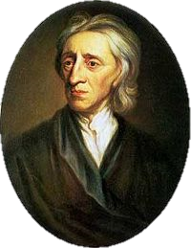
Political Liberalism
Click to read his
Two Treatises on Government
(1680-1690)
Influences:
  Philosophes: men of letters (ex: Voltaire), believed in progress in government
  John Locke
    Natural rights of individual: “life, liberty, and estate”
    Government’s job: protecting these rights
    People have right to overthrow tyrannical gov.
(“The Enlightenment”)
  (Riley)
John Locke, Philosopher
(Aug. 29, 1632 – Oct. 28, 1704)
(Kneller)

Slide 4
Ideas
Wanted
Did Not Want
Constitution
Representative gov. institutions
Freedom of press and assembly
Extension of judicial system
Separation of Church and State
Improvements in education
Administrative reforms
Democracy
Rights for women
Power for non-landowners
(Chambers 677-678)

Slide 5
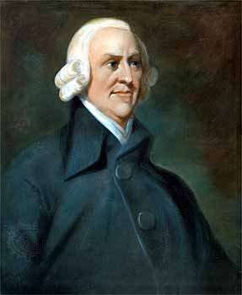
Economic Liberalism
Click to read
An Inquiry into the Nature and Causes of the Wealth of Nations (1776)
Influences:
  Adam Smith:
    Promote importing and exporting
    No gov. interference in market
    “If any branch of trade...be advantageous to the public, the freer and more general the competition, it will always be the more so”
    Concept called laissez faire
    Nation’s wealth based on production and commerce, not gold and silver
Adam Smith, Economist/ Philosopher
(June 5, 1723- July 17, 1790)
(Adam Smith)
(McKnight)

Slide 6
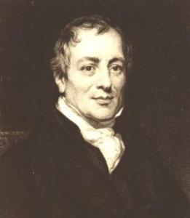
Major Figures
David Ricardo
  Early believer of monetarism: theory of money
  Trade between nations beneficial (get cheaper goods from other countries instead of expensive manufacturing)
  Labor theory of value: The more work put into product = more value of product
  Iron law of wages:
    labor plentiful = workers paid at subsistence level
    labor is low = workers paid more
    Constant fluctuation of size of labor force = fluctuation in salary
    Tends towards an equilibrium, where pay is just enough to survive
David Ricardo, Economist
(Apr. 18, 1772- Sept. 11, 1823)
(David)
(“David”)

Slide 7
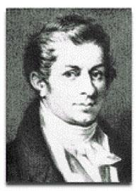
Click to read
A Treatise on Political Economy
(1803)
Jean-Baptiste Say:
  Major supporter of Adam Smith’s ideas
  Popularized Adam Smith’s Wealth of Nations for the European common market
  Producers of goods receive the buying power to buy other goods
    Overproduction isn’t a problem in the long run b/c the goods will be bought by someone
  His A Treatise on Political Economy (1803) translated into English, used as textbook in England and United States
Jean-Baptiste Say, Economist
(Jan. 5, 1767- Nov. 15, 1832)
("Jean-Baptiste Say")

Slide 8
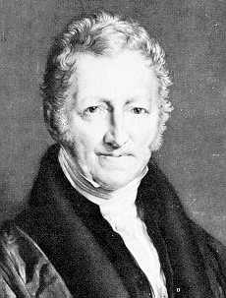
Thomas Malthus:
  Essay on the Principle of Population inspired Charles Darwin’s theory of natural selection
  Saw issues with living standards in 19th century Europe
    Saw three causes:
      Too many births
      Resources can’t keep up with population
      Irresponsibility of the lower classes
  Believed human population will outgrow food supply = famine, death, etc.
    Need regulation on sizes of lower class families to stop this
    Did not take developments in agricultural technology into consideration
Was Malthus right? Will the human population outgrow its resources? Click to find out!
Thomas Malthus, Political Economist
(Feb. 14, 1766- Dec. 29, 1834)
(Chris Troka’s)
(“Thomas Malthus”)

Slide 9
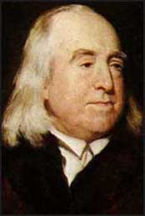
Social Liberalism
Jeremy Bentham:
  Natural rights useless
  Utility basis of public policy
  Utilitarianism: do what is good for the majority
  State has central role
  Followers: philosophic radicals
    Most important reformers in Parliament
Watch a brief video about the concept
Jeremy Bentham, Social Reformer
(Feb. 15, 1748- June 6, 1832)
(Jeremy)
(Chambers 678)

Slide 10
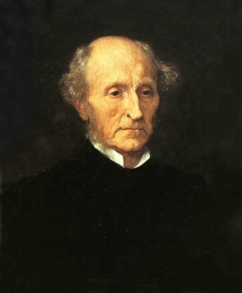
John Stuart Mill:
  Most important liberal thinker of 19th century
  Freedom
    Universal suffrage
    Open admin.
    Workers’ cooperatives
    Emancipation of women
    Liberty = productiveness, creativity, progress
(Chambers 679)
(Wilson)
Click to read
On Liberty
(1859)
John Stuart Mill
(May 20, 1806- May 8, 1873)
(John)

Slide 11
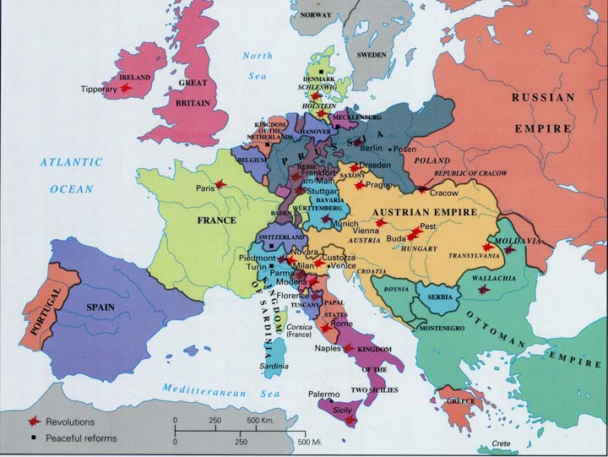
Revolution!
As liberal ideas spread, revolutions occurred across Europe
Map of Europe, 1848, depicting the various revolutions and peaceful reforms
(Map)

Slide 12
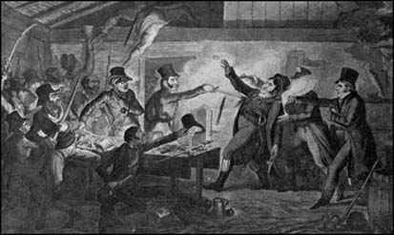
Great Britain
Mainly avoided revolutions
Sir Robert Peel’s police force and spy network able to maintain control
  Despard Conspiracy
    Colonel Edward Despard (Irish) planned revolution to overthrow King George III
      Saw his people being driven off land while English landlords enclosed land
    Executed on Feb. 22, 1803
  Cato Street Conspiracy
    Inspired by Thomas Spence, wanted small groups running gov.
    Feb. 23, 1820: Spenceans planned raiding and murder of multiple magistrates (including Lord Castlereagh), but quickly arrested
(Barkawi)
(McMillan)
Cato Street Conspiracy (Cruikshank)

Slide 13
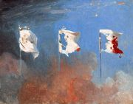
France
1830:
  Causes:
    King Louis XVIII had accepted constitutional monarchy, charter for people, parliament for voting
    Royalist wanted power of monarch:
      Brought end to revolutionary power (heavy censorship of press, Tricolot replaced by national flag)
      King Charles X even more oppressive
    July Ordinances (July 26): set of decrees issued by Charles X
      Took away voting privileges, freedoms, dissolve Parliament
Scenes of July 1830
(Cogniet)
(Pakhare)

Slide 14
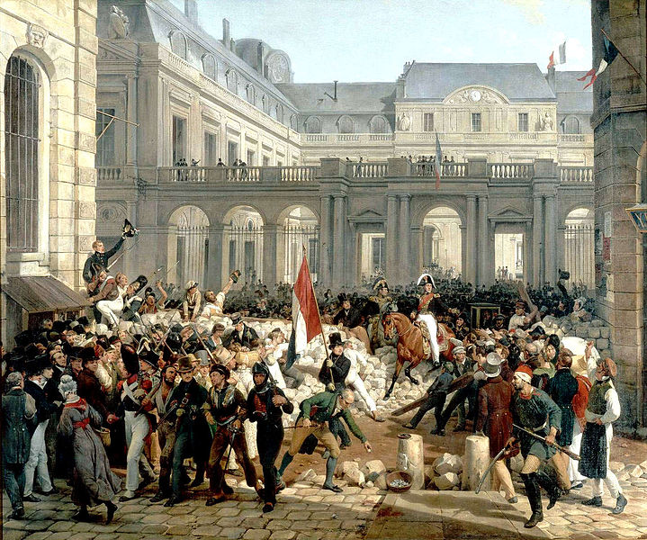
  Outraged the people
    July 27:
      Riots begin
      2000 Parisian civilians killed
    July 29:
      Revolutionaries gained control
      Barricades across the city of Paris, blocking military
      “The people’s flag” (red flag) raised
      Overthrew gov.
    August 2: Charles X abdicated throne, in favor of grandson receiving throne
      Louis Philippe (head of House of Orléans) presented as candidate by Marquis de Lafayette
      Becomes king: July Monarchy
      Provided the freedoms liberalists desired, but in moderation
        Voting rights
        Professionals replaced aristocracy
Louis-Phillipe going from the Palais Royal to the Hôtel de Ville
July 31, 1830
(Vernet)
(“The French”)

Slide 15
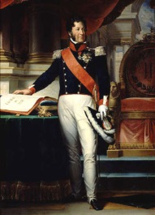
1848:
  Causes:
    Louis-Philippe tried to please everyone, but pleased no one
    Republicans didn’t see their ideas being implemented
    Reformers (lead by Adolphe Thiers) vs. those who didn’t want any changes (like Franҫois Guizot)
    Suppression of growing working class
    Socialist party (lead by Louis Blanc) born (wanted work for all, free competition in market, etc.)
  Political gatherings/ demonstrations outlawed
    Held banquets instead to criticize the regime
      Feb. 1848: this was outlawed
(Pakhare)
King Louis Philippe, The “People’s King” (Louis Philippe)

Slide 16
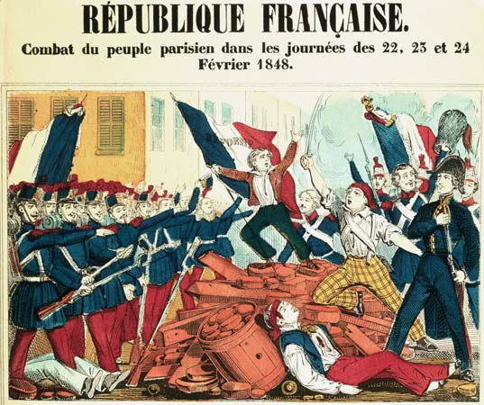
Outraged, riots broke out
  Barricades set up
  Fight between citizens and municipal guard in front of Ministry of Foreign Affairs (after Guizot resigned)
    Soldier accidently shot at crowd, followed by other soldiers
      50 civilians killed
  Mob raided royal palace
    Louis Philippe abdicated and fled to England
The people prevailed again!
  Set up republic w/ strong president, 1-house legislature
  9 million Frenchmen could vote (from 200,000 before)
(“The French”)
Colored print depicting revolt in Paris, 1848
(Revolutions)

Slide 17
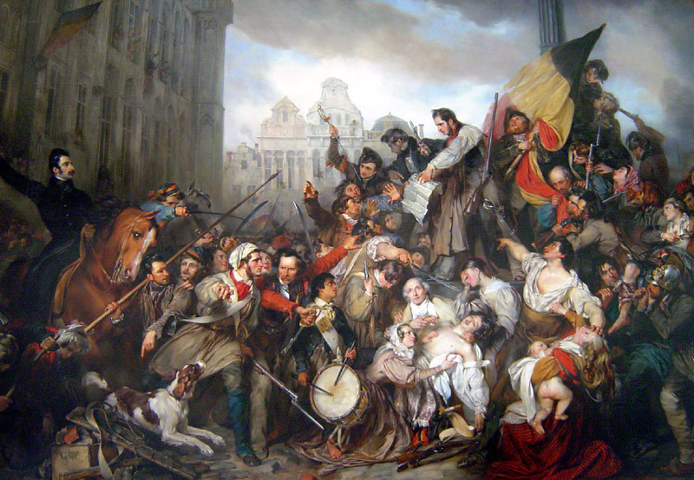
Belgium
Under rule of Dutch King William I
Inspired by 1830s revolution in France
Causes:
  Dutch tariffs favored N. Netherlands, not Belgians (S. Netherlands)
  Oppressed by king
  Imposing Calvinist ideas on people
Aug. 25, 1830:
  Citizens of Brussels rioted
  King ignored son’s advice of separating N. and S. Netherlands
  Sent army
Sept. 23-26: brutal fighting
  Citizens won
  Provincial gov. declared
Oct. 4: Declaration of Independence, establishment of Belgian monarchy
Revolution of 1830 in Beligium
(Wapper)

Slide 18
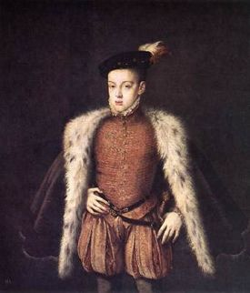
Spain
King Ferdinand VII died (1833)- left throne for 3-year-old Isabella
  Don Carlos (king’s brother) started uprising
    Carlists:
      Supported autocracy, Catholicism
    Eventually defeated, but earned place in Spanish history
  Constitution created (1834)- had limited freedoms
    Earned support of England and France
    Moderates (supporters of constitution) vs. anticlerical progressives (wanted democratic constitution)
Prince Don Carlos
(Prince)
(Chambers 700)

Slide 19
Suggested Readings
Liberalism and Modern Society: A Historical Argument by Richard Bellamy
Enemies of the State: The Cato Street Conspiracy by M.J. Trow
Les Misérables by Victor Hugo
  About 1830s French revolution

Slide 20
Works Cited
Adam Smith. Digital image. Powerpedia. Atlassian Confluence, 15 June 2011. Web. 14 Jan. 2013.
Barkawi, Tarak. "A Vision of Whole Human Race." The Nation. Nawaiwaqt Group of Newspapers, 28 Jan. 2012. Web. 12 Jan. 2013.
Cogniet, Léon. Scenes of July 1830. Digital image. Burdos Classroom. N.p., n.d. Web. 14 Jan. 2013.
Cruikshank, George. Cato Street Conspiracy. Digital image. Spartacus Education. Spartacus Educational Publishers Ltd, n.d. Web. 13 Jan. 2013.
David Ricardo. Digital image. Crawfords World. N.p., n.d. Web. 14 Jan. 2013.
"David Ricardo." The Concise Encyclopedia of Economics. Library of Economics and Liberty, 2008. Web. 13 Jan. 2013.
"Jean-Baptiste Say." The Concise Encyclopedia of Economics. Library of Economics and Liberty, 2008. Web. 11 Jan. 2013.
Jeremy Bentham. Digital image. Spartacus Educational. Spartacus Educational Publishers Ltd, n.d. Web. 14 Jan. 2013.
John Stuart Mill. Digital image. The Online Library of Liberty. Liberty Fund, Inc., n.d. Web. 13 Jan. 2013.
Kneller, Godfrey. John Locke. Digital image. Liberty Library. Constitution Society, 27 Aug. 2012. Web. 14 Jan. 2013.
Louis Philippe. Digital image. Louis-Philippe. Soylent Communications, n.d. Web. 14 Jan. 2013.
McKnight, Alexis. "19th Century Political Liberalism." Suite101. Suite101, 2 May 2010. Web. 13 Jan. 2013.
McMillan, Peter. "Cato Street Conspiracy." Spartacus Educational. Spartacus Educational Publishers Ltd, n.d. Web. 13 Jan. 2013.
Middle Class. Digital image. Social Changes Period 2. Google Sites, n.d. Web. 14 Jan. 2013.
Pakhare, Jayashree. "Causes and Events of the French Revolution." Buzzle. Buzzle, n.d. Web. 12 Jan. 2013.
Prince Don Carlos. Digital image. The Ancient Standard. The Scribe, 29 Apr. 2007. Web. 14 Jan. 2013.
Riley, Jim L. "Moderate Political Ideologies: Liberalism and Conservatism." Academic Regis. Regis University, 1990. Web. 11 Jan. 2013.
"The Enlightenment." ThinkQuest. Oracle Foundation, n.d. Web. 11 Jan. 2013.
"The French Revolutions of 1830 and 1848." Burdos Classroom. N.p., 26 Apr. 2008. Web. 12 Jan. 2013.
Revolutions of 1848. Digital image. Encyclopædia Britannica. Encyclopædia Britannica Online.
Encyclopædia Britannica Inc., 2013. Web. 14 Jan. 2013
Thomas Malthus. Digital image. Chris Troka's Home Page. Crystal Lake South, n.d. Web. 13 Jan. 2013.
"Thomas Malthus." Thomas Malthus. University of California Berkley, 4 Oct. 1995. Web. 12 Jan. 2013.
Vernet, Horace. Louis-Phillipe going from the Palais Royal to the Hôtel de Ville, 31 July 1830. Digital image. Burdos Classroom. N.p., 26 Apr. 2008. Web. 14 Jan. 2013.
Wappers, Gustaf. Episode of the Belgian Revolution of 1830. Digital image. Fanpop. N.p., n.d. Web. 14 Jan. 2013.
Wilson, Fred. "John Stuart Mill." Stanford Encyclopedia of Philosophy. Metaphysics Research Lab, CSLI, Stanford University, 3 Jan. 2002. Web. 12 Jan. 2013.

