Slide 1
Prussia: A Chapter 17 review
By: Cameron Lester, The Better Twin
Period 5 12/17/12

Slide 2
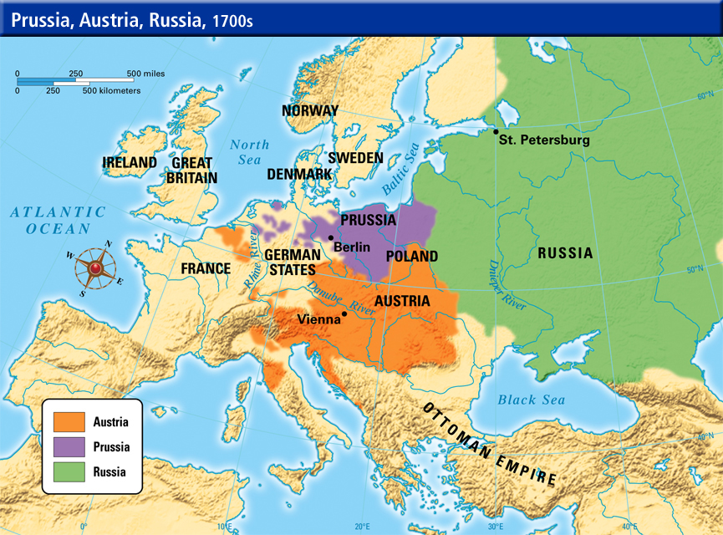
What is it and where can I find it?
Prussia is a country located between German and Russia, and above Austria and Poland
Prussia is a country ruled by the Hohenzollern family
Prussia is a military state with an army that was feared by all of Europe at its height

Slide 3
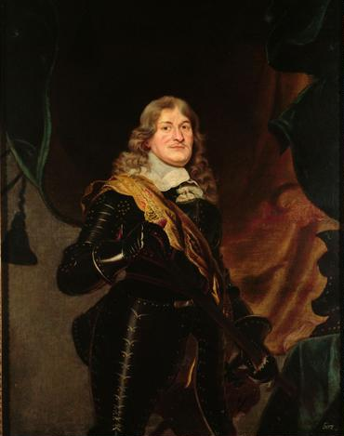
Great Elector Frederick I
Great Elector Frederick I was known for his military and political prowess
He promoted trade
He had Prussia take part in the Thirty Years’ War
Great Elector Frederick I raised an army of 40,000
He created a policy of religious tolerance
His Edict of Potsdam gave Huguenots multiple benefits and gave Protestants tax-free status for 10 years which caused a huge population rise in Prussia.
Great Elector Frederick I

Slide 4
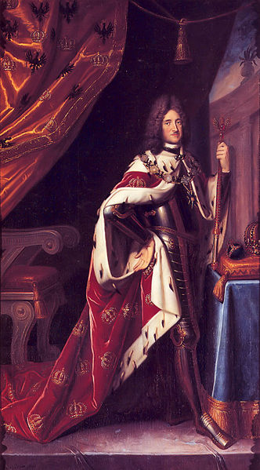
King Frederick I
Born Frederick III
Became the first royalty of Prussia under the title of king after he crowned himself so on January 18, 1701.
He was a patron of the arts and loved poetry.
Fun Fact: Though he was the first royalty technically he was never actually king OF Prussia just king IN Prussia. This was in order to prevent reducing the power of the Holy Roman Empire in the Prussian territories. As such, Frederick William I was the real first king of Prussia.
King Frederick I

Slide 5
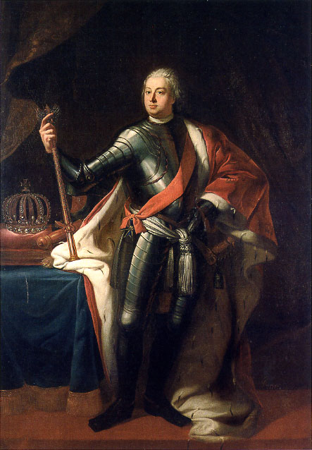
FREDERICK William I
Relentless in his pursuit of strengthening absolutism in Prussia.
Hated court life and he attempted to supervise and regulate everything all by himself – true absolutism.
Under him the army grew from
38,000 to 80,000. Foreigners made
up 1/3 of his army and all solders
went through boot camp.
He was commander in chief but
he refused to engage in battle.
His crowning achievement was his
son Frederick II
Frederick William I

Slide 6
Centralization of Prussian government
In 1723 a government superagency known as the General Directory of Finance, War, and Domains was created.
It’s goal was to united the administrations and cabinets of all these functions under one roof.
The Directory of Finance, War, and Domains did not however include the functions of justice, education, or religion.
The task it was burdened with was the collection of revenue, expenditures, and local administration.
These resources were then put into education so the public was able to be given basic instruction and public school became mandatory for children even though it was hardly ever enforced. The teachers of these schools were usually clergy and the public was not interested in their personal pursuits of knowledge and universities declined

Slide 7
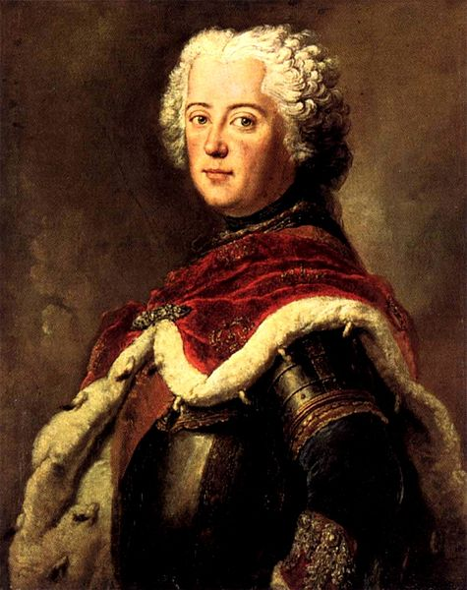
Frederick II as a prince
Opposite of his father; while his father was a God-fearing German Protestant, Frederick II was a German culture hating deist.
Frederick II preferred the arts, composing, and writing philosophy to the work that comes with being a leader.
He was extremely strongly opposed to being groomed for the position and as such he became a strong leader because of his determination etcetera – although it should be mentioned that he did eventually study to become a good leader.
Frederick II as Crown Prince 1739

Slide 8
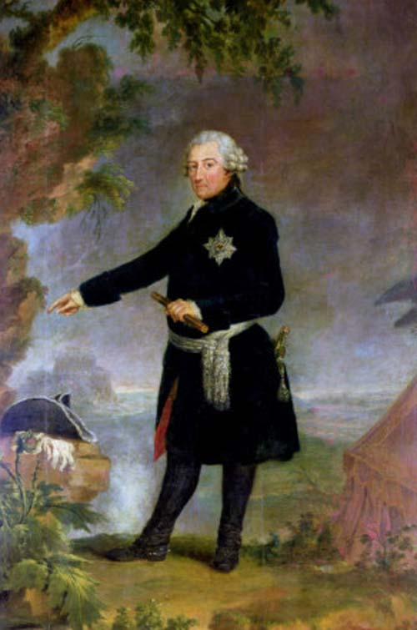
Frederick the II as king: Frederick the Great
Frederick the II took the throne in 1740 and was prepared to lead Prussia with passion.
As king he became known as Frederick the Great and though he often dealt with moral issues of his actions. He continued to struggle for power and territory.
He pushed for absolutism and tried to justify the moral implications of the policy.
More territory and stronger borders = Stronger Prussia
One of the first things he did was the conquest of Silesia.
Frederick the Great by Anna Dorothea Therbusch, 1772

Slide 9
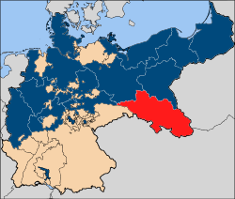
Prussia’s Conquest of silesia
The conquest was the first task given to the army under Frederick II in the First Silesian war of 1742.
When the land had been almost completely conquered Maria Theresa attempt to regain the land in the Second Silesian War (1744 – 1745)
The Second Silesian War ultimately failed for the Spanish and they were forced to relinquish their claims to the land through the Treaty of Dresden
A map of the Silesia under Prussia, the red being the land added to Prussia, blue being Prussia, and orange being Austrian claims to land in Prussia.

Slide 10
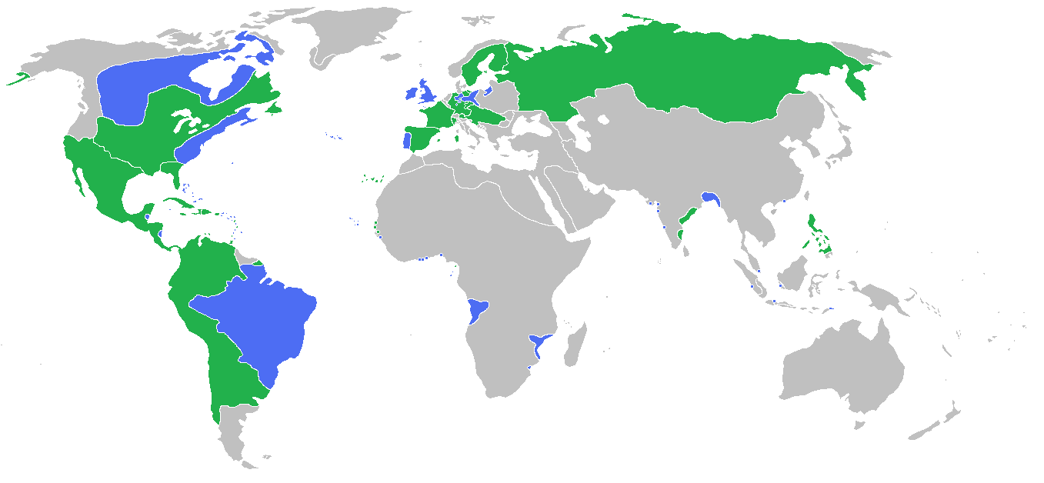
The Seven Years’ War
Map of the areas controlled by the opposing sides of the Seven Year’s War
The Seven Year’s war is said to be a continuation of the War of Austrian Succession.
The war was sparked again after Maria Theresa used the Treat of Aix-la-Chapella (signed between her and Frederick the Great in 1748) as a way to have time to build up an army to take back Silesia.
Multiple other reasons are said to have caused the alliances to form the way they were, but many of the countries just acted as proxies for the war between Prussia and Austria.

Slide 11
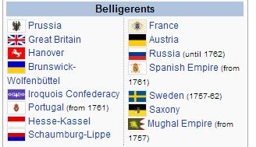
The Opposing Sides
The opposing sides were Prussia allied with Great Britain, Hanover, Brunswick-Wofenbuttel, Iroquios Confederacy, Portugal, Hesse-Kassel, and Schaumburg-Lippe.
Against Austria allied with France, Russia, the Spanish Empire, Sweden, Saxony, and the Mughal Empire.
Austria wanted to reclaim Silesia and defeat Prussia brutally while Prussia wanted to keep Silesia and acquire more land
Flags of the Belligerents of the Seven Years’ War

Slide 12
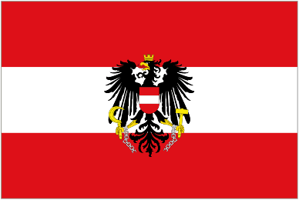
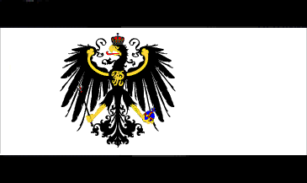
Strategies
Austria knew that Bourbon France was no longer important to them and that their alliance and position within the Holy Roman Empire was dependent on the actions of Prussia and as such they planned a “Diplomatic Revolution” against the geographically vulnerable Prussia.
Prussia wanted to try and compensate for their vulnerability through alliances with other countries and sought England for help as their protection of Hannover meant that they would sign the Convention of Westminster with Prussia in January 1756 which meant that France was now against Prussia and England was their new ally in the war.

Slide 13
Course and outcome of the war
Frederick the Great’s genius led to multiple victories but he had to run his army all across Prussia to fight off invading forces. The longer the war went on the more the threats of Russian attacks on Brandenburg and Austrian assaults through Silesia and Saxony loomed over him.
Almost exhausted entirely, Prussia faced a total collapse but the opposing side was also war-weary and his enemies became increasingly suspicious of one another and in the end Prussia was saved by the death of Empress Elizabeth in 1762 who was replaced with Tsar Peter III who admired Frederick and as such, the Tsar had Russian troops exit Prussia and William Pitt’s replacement brought about an agreement with France that ended their war that was hurting Prussia – this meant that Austria’s allies and coalition fell apart so technically Prussia won.

Slide 14
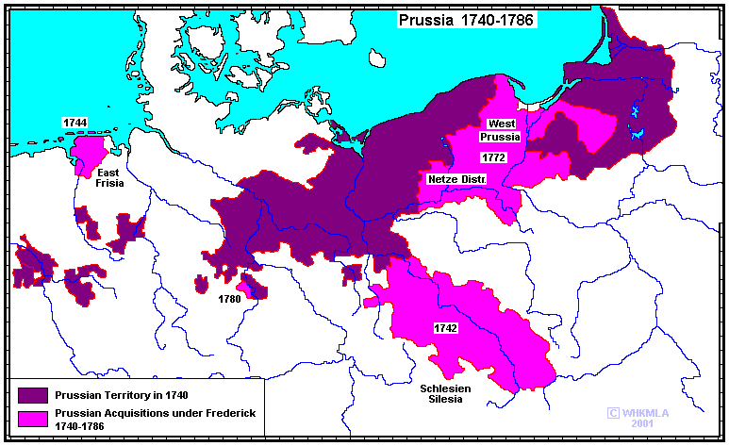
Prussia’s Gains in the War
The Seven Years’ War finally came to an end through the signing of the Peace of Hubertusburg (1763) that settled the continental phase of the Seven Year’s war in Europe.
Prussia gained allies in the war and by the end of the Seven Years’ War Prussia returned Saxony to Austria and the Prussians got to keep Silesia.
The status quo of Europe was restored and Frederick returned to Berlin
Prussia in 1763

Slide 15
Image sources
Map of Prussia
http://www.classzone.com/cz/books/ms_wh_survey/resources/images/chapter_maps/wh19_prussia.jpg
Great Elector Frederick I
http://en.wikipedia.org/wiki/File:Frans_Luycx_011.jpg
King Frederick
http://en.wikipedia.org/wiki/File:Weidemann;_Frederik_I_von_Preu%C3%9Fen.jpg
Frederick William I
http://en.wikipedia.org/wiki/File:Friedrich_Wilhelm_I_1713.jpg
Frederick II as prince
http://en.wikipedia.org/wiki/File:Antoine_Pesne_-_Frederick_the_Great_as_Crown_Prince_-_WGA17377.jpg
Frederick the Great
http://en.wikipedia.org/wiki/File:Portraitoffrederickthegreat.jpg

Slide 16
Image Sources (Cont.)
Silesia
http://upload.wikimedia.org/wikipedia/commons/thumb/0/01/Map-Prussia-Silesia.svg/250px-Map-Prussia-Silesia.svg.png
Map of the Seven Years' War
http://en.wikipedia.org/wiki/File:SevenYearsWar.png
Flags of the Belligerent of Seven Years' War
http://en.wikipedia.org/wiki/Seven_Years'_War
Flag of Austria
http://www.flags.net/images/largeflags/AUST0002.GIF
Flag of Prussia
http://www.crwflags.com/fotw/images/d/de_prus1.gif
Prussia in 1763
http://www.zum.de/whkmla/histatlas/germany/prfrederick.gif

Slide 17
Work Cited
Chambers, Mortimer. The Western Experience. Boston: McGraw-Hill, 2003. Print.

