Slide 1
Italy and Ethiopia
By David Hsu
The “Second Italo-Ethiopian War”

Slide 2
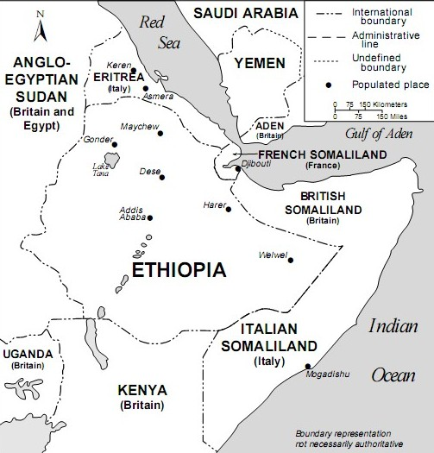
Beginning of the war
Italo-Ethiopian Treaty of 1928- allowed Italy to build works in Ethiopia but forbade Italy from building them within a certain border
Italy built a fort at Walwal, a clear violation of the treaty, led to the Walwal incident
December 1934- border clash at Walwal (Walwal incident). About 150 Ethiopians and 2 Italians dead
http://upload.wikimedia.org/wikipedia/commons/5/55/Horn_of_Africa_and_Southwest_Arabia_-_Mid-1930s.jpg

Slide 3
Ethiopian View
Leader is Haile Selassie, who repeatedly asks the League of Nations for assistance
Soldiers are anywhere between 350,000-760,000
Soldiers are poorly trained and equipped, about 400,000 rifles for all the soldiers
Some soldiers were armed with only spears and bows
Very little artillery and vehicles, with 13 aircraft in the airforce

Slide 4
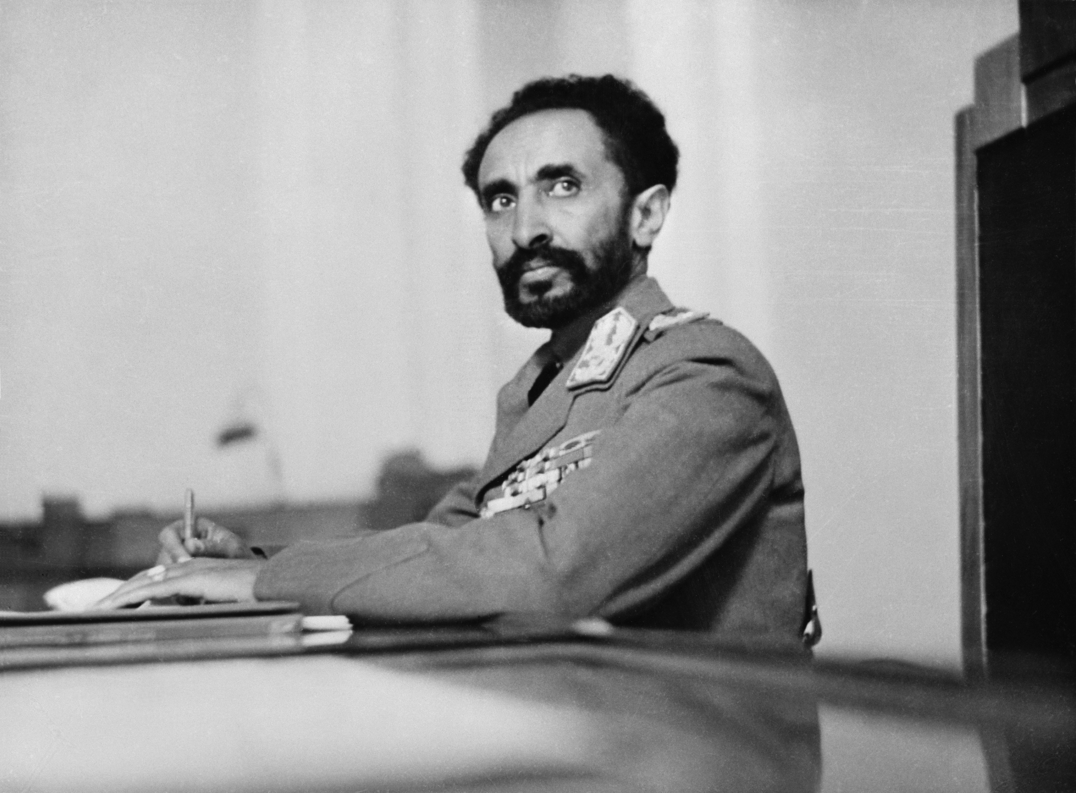
Haile Selassie
Leader of Ethiopia during the war
Made numerous speeches to the League of Nations asking for sanctions and assistance
Personally led the soldiers during the later part of the war
http://upload.wikimedia.org/wikipedia/commons/8/82/Addis_Ababa-8e00855u.jpg

Slide 5
Haile Selassie Opinion
“I ask the fifty-two nations not to forget today the policy upon which they embarked eight months ago, and on faith of which I directed the resistance of my people against the aggressor whom they had denounced to the world. Despite the inferiority of my weapons, the complete lack of aircraft, artillery, munitions, hospital services, my confidence in the League was absolute. I thought it to be impossible that fifty-two nations, including the most powerful in the world, should be successfully opposed by a single aggressor. Counting on the faith due to treaties, I had made no preparation for war, and that is the case with certain small countries in Europe. “
https://www.mtholyoke.edu/acad/intrel/selassie.htm

Slide 6
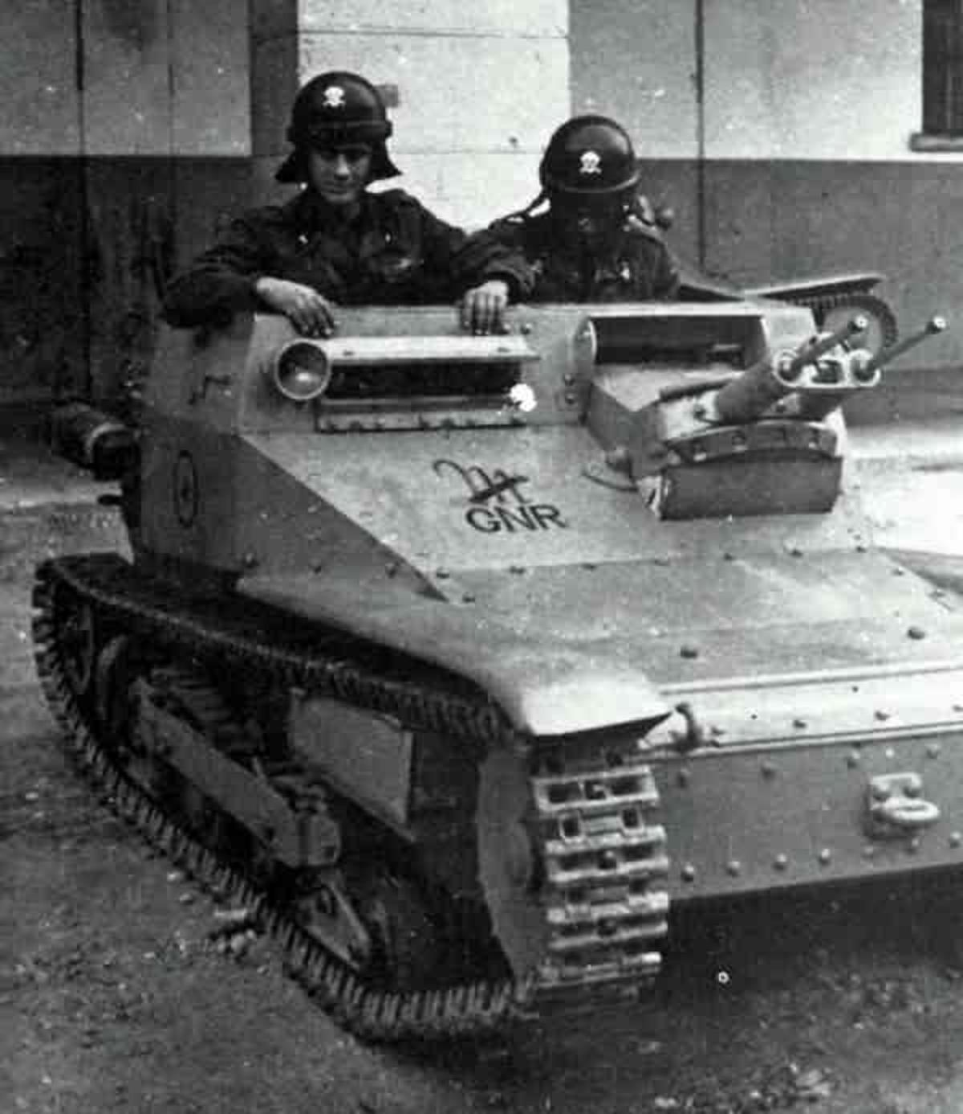
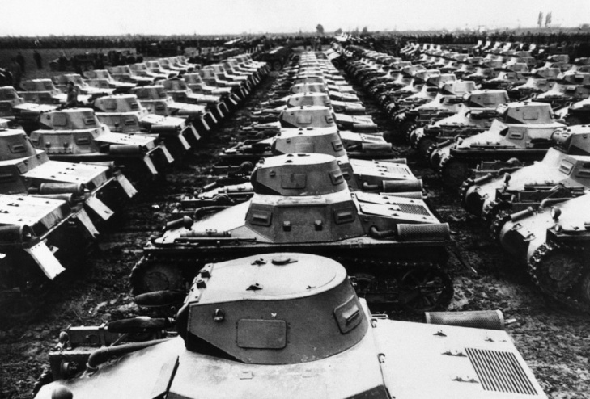
Italian Side
Added about 685,000 troops to the roughly 600,000 troops already in East Africa
Well equipped, were also resupplied by the Italian Royal Navy
Also included colonial troops (from Eritrea, Somalia, and Libya) which were fairly effective
Had modern weaponry such as tanks, aircraft, and artillery
(left) Battle tanks of the era, the Italian invasion forces included about 600 of these
Tankette: A lighter form of the battle tank, the Italian forces had about 200 of these
http://gothicline.files.wordpress.com/2009/01/gnr.jpg
http://wodumedia.com/wp-content/uploads/2012/11/The-German-army-demonstrated-its-might-before-more-than-a-million-residents-during-the-nationwide-harvest-festival-at-B%20%20ckeburg-near-Hanover-Germany-on-Oct.-4-1935.-Here-are-scores-of-tanks-lined-up-just-before-the-demonstra-960x651.jpg

Slide 7
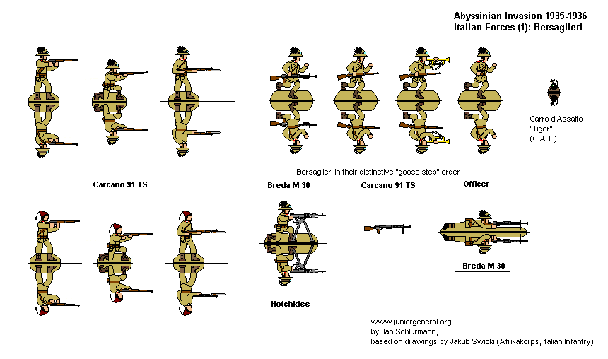
What Italian forces may have looked like
http://www.juniorgeneral.org/donated/jan/AbItalians1.gif

Slide 8
League of Nations Reaction
Call for arbitration for the Walwal incident
Meet for peace talks and discuss concessions to Italy (rejected by Italy)
Britain employs an arms embargo on both sides of the conflict
After Italy is declared the aggressor, countries begin to sanction Italy

Slide 9
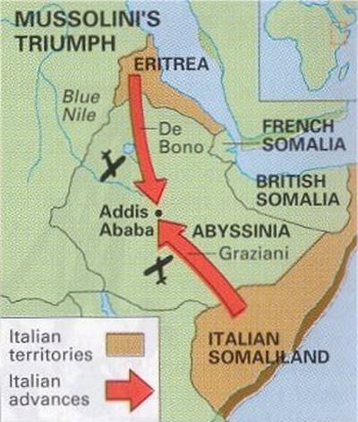
The War
Italy invades without formal declaration of war, prompting the League of Nations to respond
League of Nations responds by condemning Italy, employs sanctions against Italy (these did not include steel or oil)
General De Bono and Rodolfo Graziani lead the attack against Ethiopia, are extremely successful, leading to a rapid advance through Ethiopia
http://www.warchat.org/pictures/second_italo-abyssinian_war_1935-1936_war_map.jpg

Slide 10
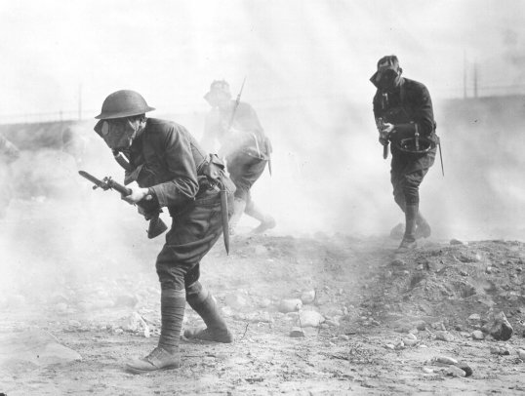
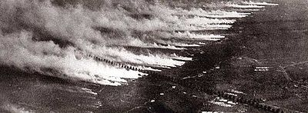
The War (continued)
Hoare-Laval Pact signed- plans to cede 2/3 of Ethiopia to Italy and end the war. It is never put into effect
De Bono is replaced by Badoglio, who is authorized to use mustard gas against Ethiopian troops and villages (direct violation of 1899 and 1907 Hague Conventions)
http://upload.wikimedia.org/wikipedia/commons/thumb/0/09/Poison_gas_attack.jpg/400px-Poison_gas_attack.jpg
http://25.media.tumblr.com/tumblr_m0qo0bQcCP1qit8gno1_1280.jpg

Slide 11
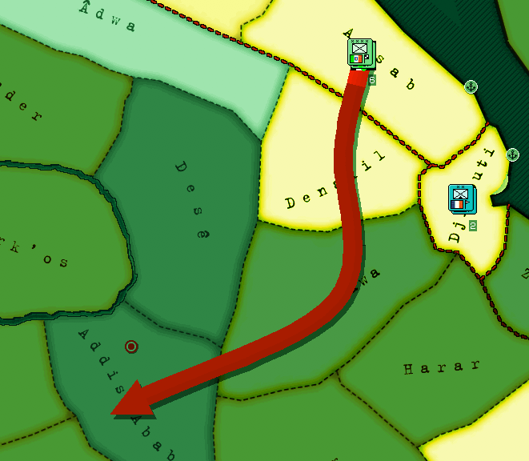
The Surrender
Ethiopia counterattacks in the “Christmas Offensive” and the Battle of Maychew, both fail
Badoglio leads the “March of the Iron Will,” a mechanized march capturing Addis Ababa in a show of force and ending the war
Italy annexes Ethiopia officially on May 7, 1936
http://img56.imageshack.us/img56/643/picture13l.png

Slide 12
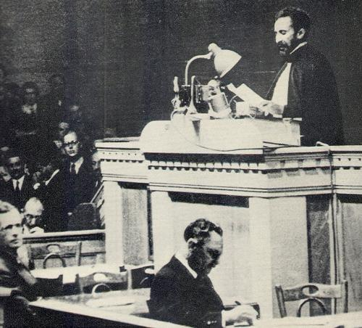
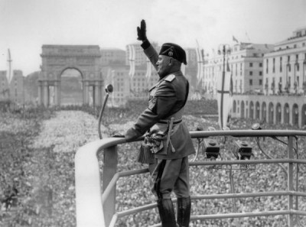
After the surrender
The League of Nations condemns the Italian actions
Mussolini explains “At last Italy has her empire… Will you be worthy of it?”
Haile Selassie comments “It is us today. It will be you tomorrow” after being humiliated while speaking
http://www.blackpast.org/files/blackpast_images/Selassie__Halie.jpg
http://upload.wikimedia.org/wikipedia/en/9/97/Benito_Mussolini_Roman_Salute.jpg

Slide 13
Overall effects
Most countries accepted Italy’s occupation of Ethiopia, with the exception of the USSR and the United States
It proved the League of Nation’s ineffectiveness in peacekeeping
Showed Italy’s ability to break rules, such as the 1925 Geneva Protocol, by employing such tactics as using flamethrowers and mustard gas, as well as the tactic employed by the Italians afterward of killing all “rebels” in Ethiopia, total about 700,000 Ethiopians dead, with less than 300,000 in combat

Slide 14
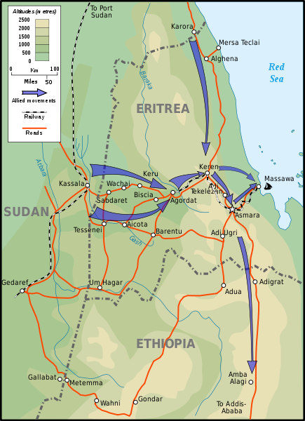
After the War
During World War II, Italy began to invade Africa, forcing other colonies to flee
During the East African Campaign, Ethiopia was liberated by a combination of Allied forces
When Italy surrendered, the Treaty of Peace with Italy guaranteed Ethiopian independence
Haile Selassie was restored to leader
Italy paid for reconstruction, about £180 million
http://en.wikipedia.org/wiki/File:EritreaCampaign1941_map-en.svg

Slide 15
Websites Used
http://en.wikipedia.org/wiki/March_of_the_Iron_Will
http://en.wikipedia.org/wiki/Hoare-Laval_Plan
http://en.wikipedia.org/wiki/Italo%E2%80%93Ethiopian_Treaty_of_1928
http://en.wikipedia.org/wiki/Timeline_of_the_Second_Italo-Ethiopian_War
http://en.wikipedia.org/wiki/Second_Italo-Ethiopian_War
Image links underneath images

