Slide 1
Austro- Prussian Franco-Prussian Wars
Maya Halthore
1/26/12
Period 5 Kinberg

Slide 2
Before We Begin… People You Should Know
Otto Von Bismarck (1815-1898)
Prussian Junker and member of the landowning class.
Despised democracy and claimed Germany could only be united “by blood and iron” and not by speeches
Became the chief minister of Prussia in 1862
Determined to avoid the revolutions of 1848
Emphasized the importance of the military, was an amazing politician
Believed that the ends justified the means. He is REALLY IMPORTANT!!!!

Slide 3
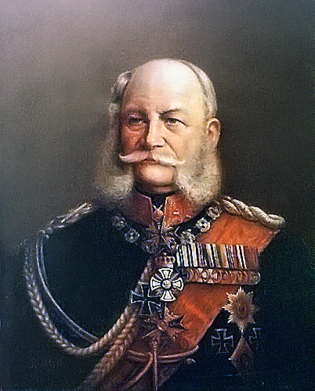
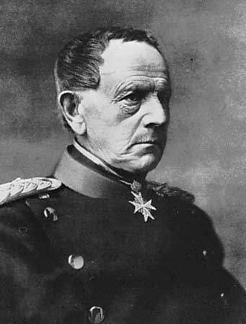
Before We Begin… People you should Know
Wilhelm I (ruled 1861-1868)
Helmuth von Moltke (1800-1891)
King of Prussia
Become emperor in 1871
Fully supports Bismarck’s policies that lead to a unified German Empire
Prussian general and chief of staff.
He built a strong army and navy that helped Bismarck’s success

Slide 4
Before We Begin… People You Should Know
Louis Napoleon Bonaparte
Napoleon’s nephew, elected president of the Second Republic of France
Dedicated his presidency to law and order, eradication of socialism, and the betterment of his people
Proclaimed himself in 1852 Emperor Napoleon III of the Second French Empire

Slide 5
Causes of the Austro-Prussian War
Prussia had a rise in military power.
-in 1861, the Prussia Parliament refused to grant the military budget that Bismark and Wilhelm I requested. The Prussia Parliament was comprised of liberals, considered the Prussian Junkers (who gave a lot of money to the military) rivalries of the state
-Wilhelm wanted to make his military the best in the world once again. Bismark then ran the government ilegally, secured funds, created an amazing military force.
Prussia had dominance over the whole entire German Confederation. It had much influence over the now unified states.

Slide 6
Causes of the Austro-Prussian War
The “Schleswig-Holstein” Question
-The two duchies of Schleswig and Holstein had been long united under a single duke and a single government.
-When that duke died and his heirs proved to be incompetent, the two states fell into disrepair.
-Denmark, seeing the opening to gain more lands, undertook the government of both states “which were never to be separated.” Schleswig became a vassal state of Denmark, and Holstein a state of the recently unified Germany
-In 1846, the two states demanded for local independence. Denmark then overtook both of the states. This led too…

Slide 7
Causes of the Austro-Prussian War
The Danish War (1864)
- Denmark attempted to annex the two states
-In 1864, Schleswig and Holstein were both occupied by the allied forces of Austria and Prussia. Because of what Denmark attempted to do, this lead to an all out war between Denmark and essentially Germany.
-Denmark was quickly defeated by Prussia and Austria. Holstein was given to Austria and Schleswig was given to Prussia.
-Prussia and Austria disagreed over the administration of the two provinces.

Slide 8
Austro- Prussian War (1866)
Austria and Prussia’s quarrels over the administration of Schleswig and Holstein included issues such as who should keep internal order of the two states and who should have the right of passage across the land
Bismarck noticed that tension was rising between the Hapsburg empire.
He prepared for war while ensuring Austria’s diplomatic isolation

Slide 9
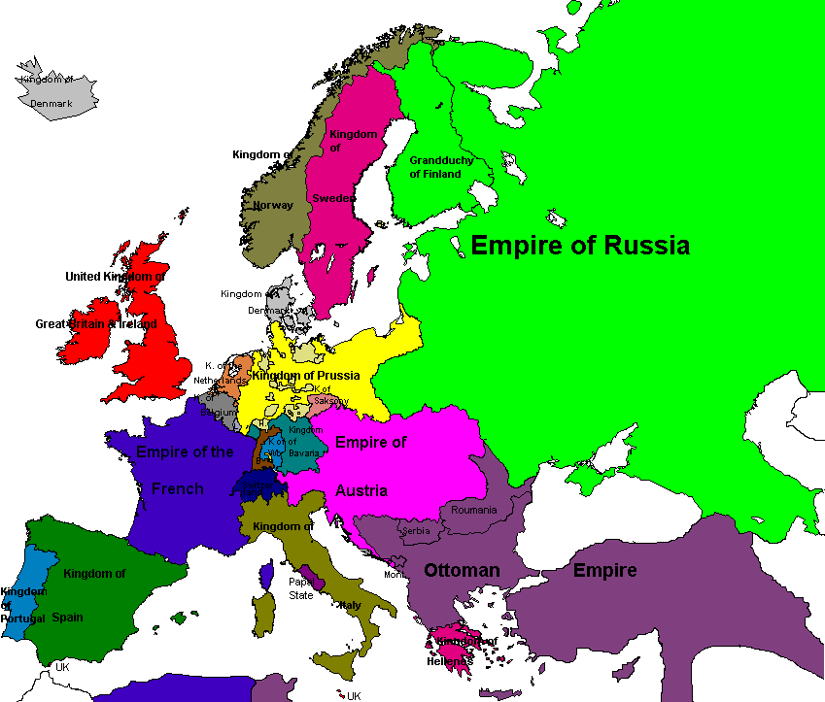
Austro- Prussian War (1866)
What Bismarck did to ensure victory:
Bismarck dangled visions of territory along the Rhine before Napoleon III, ensuring France’s help
Bismarck won Italy’s support for the war
He ensured that Russia would stay neutral throughout the battle
Meanwhile in Austria…
Had the support of most of the German Confederation

Slide 10
Austro- Prussian War (1866)
And so the war begins
It is called the Seven Weeks War because the battle literally lasted seven weeks
The German State of Hanover (which was in alliance with Austria) surrendered to Prussia after just two weeks of battle
The winning battle was in Sadowa, Austria. Three Prussian armies swept into the Bohemian state and just about destroyed the Austrians
The victory was due in part to General Helmuth von Moltke who showed military brilliance by crushing the Austrians so quickly

Slide 11
Results of the War
After Prussia defeated Austria, King Wilhelm I and most of the Prussian Conservatives and generals wanted to take advantage of the win and go for territorial gains
Bismarck said no. He understood that in the coming years there would be an inevitable conflict with France and when that happens, Prussia would need Austria’s help
He settled on leniency. There were no huge territorial gains, but “Prussia’s gains elsewhere changed the face of Europe” (Chambers 725).

Slide 12
Results of the War
In 1867, Bismarck dissolved the German Confederation
Established a confederation of North German states under Prussian leadership. This means that it was ruled by the Prussian king and a bicameral legislature
Got the South German states to accept a military alliance with Prussia.

Slide 13
The North German Confederation
Ruled by the Prussian King and a bicameral legislature
A Bismarckian structure that seemed to protect local interests and to point towards a democracy yet was still dominated by Prussia
The legislature was composed of two houses: the lower house, which was the Reichstag, represented all the people under universal male suffrage, and the upper house, the Bundesrat, which had forty-three delegates sent from various states. Prussia had seventeen delegates on its own ensuring it dominance over the legislature. Also the king had right to veto anything
Prussian Parliament legalized all the taxes Bismarck wanted to impose

Slide 14
Yet, with all of this….
Bismarck, and almost all other nationalists did not believe that the North German Confederation would be a satisfactory or permanent solution on Germany’s full unification.
Germany’s full unification would be achieved in a series of wars, treaties, and diplomacys
Differences culturally, religously, and socially between Northern and Southern Germany ensured that full unification would take a while

Slide 15
Beginnings of the Franco-Prussian War
Bismarck believed that the only way the North German Confederation and the Southern German States could be unified was through war. It has been four years since the Austro-Prussian War
Provoked by competition over influence in Spain. Queen Isabella II had been forced to abdicate the throne in 1868.
After the abdication, the provisional government replaced her with a Hohenzollern Prince (if you don’t know, the Hohenzollerns are the line of Prussian royalty)

Slide 16
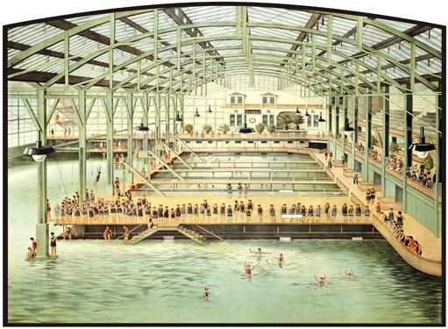
Beginnings of the Franco-Prussian War
After tons of pressure from the French, the Hohenzollern prince declined the crown
This wasn’t enough for the French, they wanted a wholehearted refusal so they could gain popular favor at home. This led to the bathtub incident.
In a spa in Western Germany, where Wilhelm I was bathing, the French ambassador demanded a public guarantee that the Hohenzollern candidacy would not be put forward again.
The king refused and telegraphed what happened to Bismarck

Slide 17
Beginnings of the Franco-Prussian War
Bismarck saw his opening to provoke the French and changed up the whole telegraph the king had sent him.
He made the question that the French ambassador posed more imperious and the king’s refusal harsher and more abrupt. He then released this new copy to the press.
“The French government responded to the patriotic fury it had helped ignite and declared war on Prussia in July 1870” (Chambers 726).

Slide 18
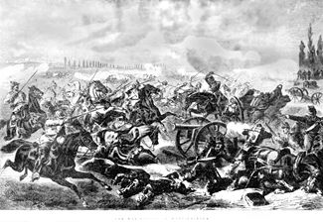
The Franco-Prussian War 1870
France hoped for help from both Italy and Austria, but had failed to make formal treaties before the war. These two countries remained neutral
The French army was much better equipped than the Austrian army, yet Germany was much better prepared for the war

Slide 19
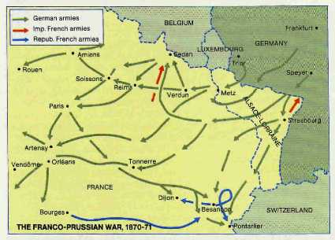
The Franco-Prussian War 1870
German armies moved through Alsace and surrounded the French army at Metz in France
Though many forces attempted to overthrow the Germans at Metz, none could succeed.
In September of 1870 at Sedan, Napoleon III surrendered and was taken prisoner by the Germans. This ended the Second Republic in France
All the major fighting was over yet there was still French resistance

Slide 20
Ending the Franco-Prussian War
Paris still resisted the Germans
Because of this German troops surrounded Paris and were quite cruel to the inhabitants. They starved the city for nearly five months forcing it into submission
The Treaty of Frankfurt in May 1871 gave the lands of Alsace and Lorraine to Germany. The French also paid a huge indemnity to Germany

Slide 21
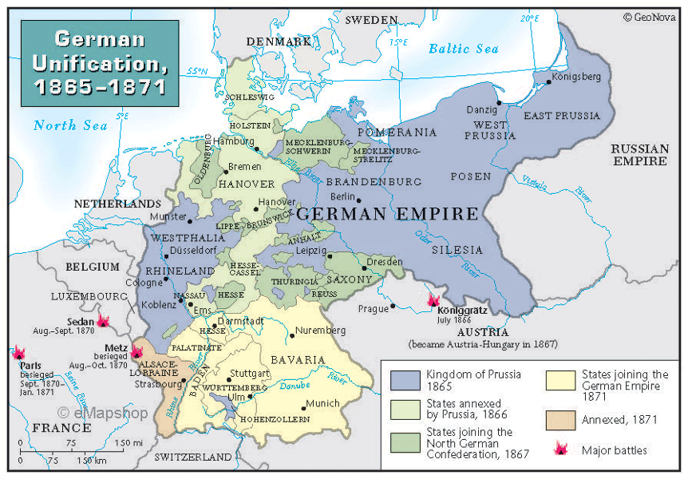
Results of the War
The completed German Empire
Because of the cruelty Germany, under Bismarck, showed France, French and Germany relations would be would be filled with hate and anger, leading to the soon to be horrors of World War One

Slide 22
Work Cited
"Austro-Prussian War." Infoplease. Infoplease, 2002. Web. 27 Jan. 2013.
Austro-Prussian War of 1866. Digital image. Zonnet. N.p., n.d. Web. 27 Jan. 2013. <home.zonnet.nl/gerardvonhebel/1866.htm>.
The Franco-Prussian War, 1870-1871. Digital image. Ancestry.com. N.p., n.d. Web. 27 Jan. 2013.
Fyffe, Charles A. "Austro-Prussian War." Austro-Prussian War. History- World, n.d. Web. 27 Jan. 2013.
German Unification, 1865-1871. Digital image. The Map Shop. The Map Shop, 2013. Web. 27 Jan. 2013.
Hanawalt, Barbara, Theodore K. Rabb, Isser Woloch, Raymond Grew, and Lisa Tiersein. "National States and National Cultures." The Western Experience. By Mortimer Chamber. 9th ed. N.p.: McGraw Hill, n.d. 706-33. Print.
Moltke, Helmuth von. Photograph. Britannica Online for Kids. Web. 27 Jan. 2013. <http://kids.britannica.com/comptons/art-151586>.

Slide 23
Work Cited
Mickens, Leah. Emperor Wilhelm I. Digital image. The Breman Museum. N.p., 2008. Web. <thebreman.org>.
Napoleon III. Photograph. Britannica Online for Kids. Web. 27 Jan. 2013. <http://kids.britannica.com/comptons/art-152735>.
North German Confederation. Digital image. BBC. BBC, 2013. Web. 27 Jan. 2013.
Otto Von Bismarck. Digital image. Wikipedia: The Free Encyclopedia. Wikipedia, n.d. Web. 27 Jan. 2013. <en.wikipedia.org>.
Prussian Infantry at the Battle of Spicheren. Digital image. Wikipedia: The Free Encyclopedia. Wikipedia, 2012. Web. 27 Jan. 2013.
The Revolutions of 1848 and the Making of Nation States in Italy and Germany. Digital image. Mtholyoke. N.p., n.d. Web. 27 Jan. 2013. <mtholyoke.edu>.
Roberts, Seth A. "The Growth and Suppression of Democracy from the AGe of Metternich to the First World War." AP European History. By James M. Eder. 5th ed. New York: Baron's Educational Series, 2010. 181-201. Print.
Romano, Michael J., Ph.D. "The Age of Nationalism in Europe." AP European History. 2nd ed. N.p.: Wiley, 2010. 131-44. Print.
Sultro Bath House. Digital image. True Art Works. N.p., n.d. Web. 27 Jan. 2013. <trueartworks.org>.

