Slide 1
NEW ECONOMICS of the 18th century
by Justin Liu, taxi-driving extraordinairre

Slide 2
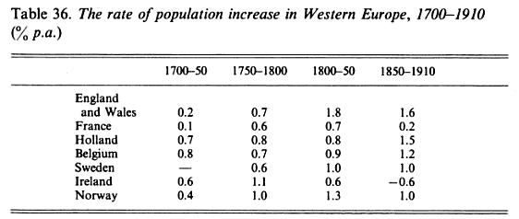
Population Growth & Inflation
A trend of population growth was seen across all of Western Europe beginning in the 1700’s due to the conditions, leading to either a fall in mortality rates, which occurred on the continent, or a rise in birth rates, which occurred in England.
The rise in population aided economic growth beginning in circa 1730 all the way until 1815. However, it also led to profit inflation in several countries due to the increasing demand for food, services, and goods.
Examples of the price increases can be seen in France; between 1726 and 1789, the prices rose on an average of about 65%. The price of grains rose higher and rents shot up. The wages increased only about 22%, thus leading to major competition for employment and profits increased for tenants and manufacturers (Olsen 198).
The accompaniment of low wages with price increases led to many social and economic effects for those of the countryside and merchants and manufacturers within the cities.
(Tranter)

Slide 3
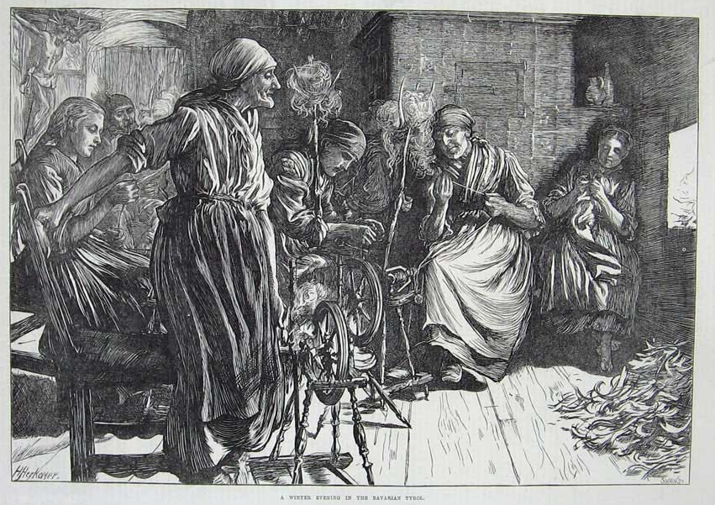
PROTOINDUSTIALIZATION
Protoindustrialization is the period before the industrial revolution and the major institutions of the factory systems.
This period of economic development consisted mainly of the putting-out system for goods such as textiles. The putting-out system was mainly controlled by merchants, as they supplied the raw materials needed to manufacture goods to rural families (Berg 60).
Protoindustrialization had many effects on that society in many aspects. Not only did it help increase capital and revenue for rural families, but it also led to growth in the urban cities and an increase in marriages for more production in rural industries (Ogilvie 2).
With these benefits of protoindustrialization, though, was the lack of technological innovation that later spurred the industrial revolution.
(“Proto-industrialization”)

Slide 4
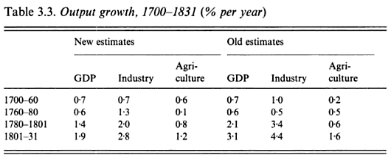
INDUSTRIALIZATION
The beginning of the industrial revolution allowed for a shift in focus from agriculture to industry, as well as an increase in urban population across the western countries of Europe, such as England and France.
With the industrial revolution came the institution factory systems in an effort to increase production and gross domestic product efficiently through the use of machinery developed during the eighteenth century.
Such was so that it was evident that along with the growth in population was the increase in gross domestic product of the countries in their industries and agriculture over the course of the eighteenth century to the early nineteenth.
(Floud and McCloskey 47)

Slide 5
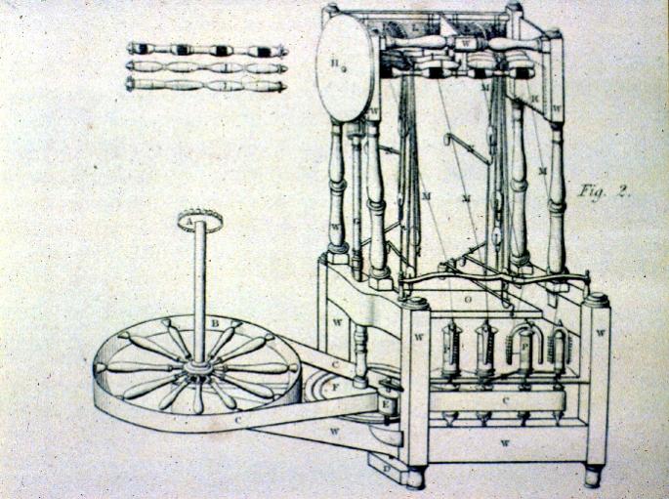
Arkwright’s Water frame
In response to the uneven efficiency in the production of textiles, Richard Arkwright invented a water frame that was automatically run through the utilization of waterpower.
It drew and spun cotton fibers, making them into threads very quickly. Thus Arkwright contributed to the increased efficiency in production of textiles through usage of water (Berg 210).
Diagram of Arkwright’s water frame (“Richard Arkwright”).

Slide 6
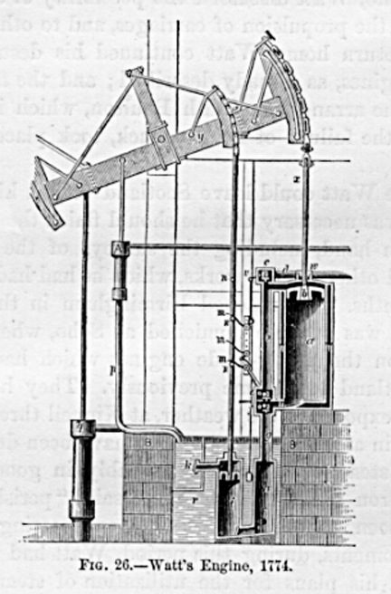
Watt’s Steam Engine
Around the same time as the development of Arkwright’s water frame was the improvement and usage of technology powered by steam by James Watt.
Watt soon designed a steam engine using cylinders and pumps that was much more powerful and efficient than previous engines (Webb 47-48).
This led to the switch of Arkwright’s water frame power supply from water to steam. Arkwright and Watt later collaborated to create the modern factory system with both Arkwright’s machinery and Watt’s steam engine.
Diagram of Watt’s steam engine (“Primary Sources…”)

Slide 7
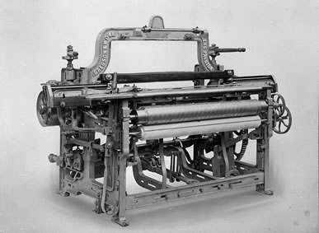
Cartwright’s Power Loom
Following the developments of Arkwright’s water frame and Watt’s steam engine in a sort of domino effect for production, there was a gap between the speed of which thread was spun and the speed of which it was weaved into a product, just as how spinning thread could not keep up with the production of cloth before.
This then led to another invention of a machine by Edmund Cartwright, who would cater the problem by creating a power loom. Cartwright’s power loom was automatic and over seven times more efficient than a skilled weaver (Knight 54).
This drastically elevated the amount of production of textiles, as the entire production chain was now catered to by the different machinery invented during the century.
Cartwright’s power loom (“1785 Edmund Cartwright…”).

Slide 8
CONVERTIBLE HUSBANDRY
Convertible husbandry was an innovative method for effective crop rotation, going against the traditional fallowing of the unused plot of land and instead planting certain crops and allowing livestock to manure in order to re-fertilize the soil.
Specifically, after the soil had been used for planting major crops like grains, grasses or turnips would be planted in order to allow grazing for animals and, in turn, the re-fertilization of the soil from the manure of the livestock (Perry 354).
This method was first majorly adopted by Jethro Tull, a British landlord and agriculturalist. His advocating of convertible husbandry and evident success led to many other landlords to follow suit. This increased productivity overall, as the yields would generally be much greater and more product would be grown (“Jethro Tull”).

Slide 9
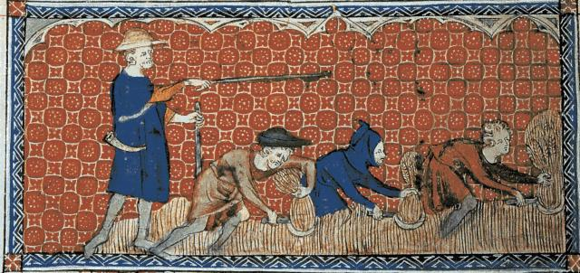
SERFDOM
In the eastern countries of Europe, serfdom was still prominent in their societies, as nobles owned the majority of the land.
The peasants would work unpaid, and were treated very harshly in all countries. They were all but slaves, as they could be sold and traded.
The peasants had very limited rights as serfs. Some countries did give peasants basic rights, but nothing more. However, some countries, such as Russia, did not, and so the treatment was even more severe for the serfs.
Serfs were corporally punished and were completely controlled by both their respective lords and the state.
(“Serfs and Peasants…”)

Slide 10
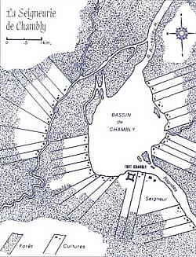
SEIGNEURIALISM
In western Europe, however, serfdom was less prominent, and the system of seigneurialism was more common. This system contrasted greatly with that of serfdom in the east, as, though it still involved peasants, it seemed relatively more civilized in its proceedings.
The peasants under a noble under the seigneurial system owed obligations and various fees to the landowner as a price for dependence on the lord and his land. With this relationship came the establishments of the lord of civil court, laws, and rights that were given to each of his subjects.
The seigneurial system was very prominent in the European countries of France, Germany, Spanish, and Italy.
The seigneurial system did not promote technological innovation, as customs and traditions were the surest guides of the peasants who did not want to act radically or become inventive when they were satisfied with their current methods.
Land allocation under the seigneurial system (“Land Concessions…”).

Slide 11
Open Field System & ENCLOSURE
In Britain, most of the lands of the villages were under the open-field system, in which strips of land were owned and much of it was relatively disorganized in terms of ownership. The open-field system limited any sort of technological innovations or increased efficiency at the time.
Landowners desired to enclose their own properties. However, this was not allowed without the consent of all others of the village and landowning neighbors. This was done though enclosure acts issued by Parliament for a specific village in which the land of the village was to be compacted and enclosed for each landowner. In the 1750s, 156 acts of enclosure were passed; from in the first decade of the nineteenth century, 906 were passed (Chambers 537).
The enclosure movement had socially impacted those villages in that the poor could not utilize what was before the common land, and thus many had to sell what little land they had left for themselves and move to the cities.

Slide 12
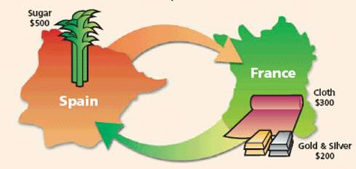
MERCANTILISM
The mercantilist policy is an economic doctrine in which the government controls the majority of the foreign economic affairs of the country, also employing a balance of trade and a higher number of exports over imports. This is based off of the idea that there is a limited amount of bullion and that the only way for one country to prosper is at the expense of another.
The mercantilist policy was utilized by the governments in order to gain economic advantage over other countries through a balance of trade in crops and manufactured goods, exploitation of colonies, and establishment of control over imports and exports through tariffs and prohibitions.
Several European powers, including Britain, France, and Prussia, were originally mercantilist countries. Gradually, a less government-controlled economy began to be supported by manufacturers and factory owners in the laissez-faire economic theory (Chambers 543).
An example of balance of trade
(“Mercantilism”).

Slide 13
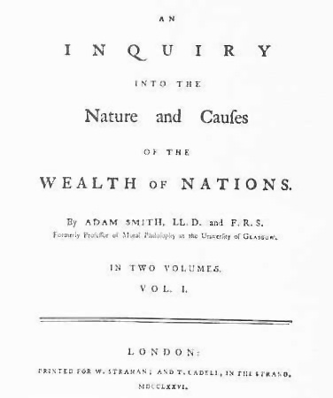
LAISSEZ-FAIRE
The laissez-faire economic doctrine, first coined by Jean-Baptiste Colbert, consists of allowing parties to pursue their own economic interests without government interference. This doctrine was developed in opposition of the mercantilist policy.
The laissez-faire economic doctrine was advocated by a Scottish philosopher by the name of Adam Smith in his An Inquiry into the Nature and Causes of the Wealth of Nations, written in 1776.
Such an economic theory began to gain support throughout Britain and, eventually, throughout France, leading to the guilds and restrictive trade of France and the laws regulating apprenticeships of Britain to be completely dissolved in the 1790s, allowing economic growth and increased industrialization.
Wealth of Nations by Adam Smith (Streminger)

Slide 14
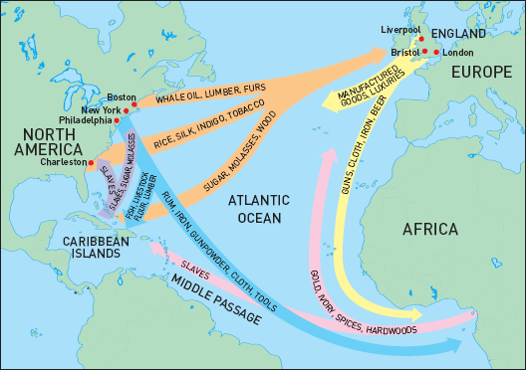
TRIANGULAR TRADE
Great Britain, a very economically prosperous country at the time, participated greatly in what is known as triangular trade, which is trading between the home country and two overseas areas, such as the country’s colonies.
The most important of these colonies were in New England and the West Indies. The triangular trade between Great Britain and its colonies allowed for a great diversification of distributed goods and trades.
From Britain to New England were paper, knives, pots, and blankets; from New England to the West Indies, fish oil, fish, beef, and timber; and from the West Indies to Britain, sugar (Chambers 544).
Another variation of triangular trade included the exchange of slaves in West Africa.
(“Triangular Trade”)

Slide 15
Empires
During the eighteenth century, a war known as the “Great War for Empire” occurred between the British and the French in an effort to subdue one another and destroy any economic advantage one may have over the other. The majority of the victories went to Britain, and so Britain gained access to the lands of India and a new empire.
Portugal, Spain, and the Netherlands all receded from their global expansion and became relatively passive and neutral in their international affairs.
The Dutch’s economy fell drastically as the English and the French did not wish to depend on them in their economic affairs. Thus, the Dutch adapted and became financial brokers, working more in the stock market and the bank rather than in trade, as they had before (Chambers 542).

Slide 16
Works Cited
Berg, Maxine. The Age of Manufactures, 1700-1820: Industry, Innovation, and Work in Britain. London: Routledge, 1994. Print.
Chambers, Mortimer. The Western Experience. 9th ed. Boston: McGraw-Hill, 2007. Print.
Floud, Roderick, and Paul Johnson. The Cambridge Economic History of Modern Britain. Vol. 1: Industrialisation, 1700-1860. Cambridge: Cambridge UP, 2004. Print.
"Jethro Tull." Berkshire History. N.p., n.d. Web. 19 Dec. 2012.
Knight, Charles. The Popular History of England. New York: J.W. Lovell, 1880. Print.
"Land Concessions Based on the Seigneurial System." Parks Canada. N.p., n.d. Web. 19 Dec. 2012. <http://www.pc.gc.ca/lhn-nhs/qc/fortchambly/natcul/natcul2/k.aspx>.
"Mercantilism." Mercantilism3. N.p., n.d. Web. 19 Dec. 2012.
Ogilvie, Sheilagh C., and Markus Cerman. European Proto-industrialization: An Introductory Handbook. Cambridge [England: Cambridge UP, 1996. Print.
Olsen, Kirstin. Daily Life in 18th-century England. Westport, CT: Greenwood, 1999. Print.

Slide 17
Works Cited (continued)
Perry, Marvin, Myrna Chase, James R. Jacob, Margaret C. Jacob, and Laue Theodore H. Von. Western Civilization: Ideas, Politics, and Society. N.p.: n.p., n.d. Print.
"Primary Sources: The Industrial Revolution." The University of North Carolina at Pembroke. N.p., n.d. Web. 19 Dec. 2012.
"Proto-industrialization." UnderstandingSociety. N.p., 14 Sept. 2010. Web. 19 Dec. 2012.
"Richard Arkwright in "Cotton Then and Now"" Belper Derbyshire. N.p., 27 July 2011. Web. 19 Dec. 2012.
"Serfs and Peasants..." Subversify Magazine. N.p., 27 Jan. 2012. Web. 19 Dec. 2012.
Streminger, Gerhard. Wealth of Nations. Digital image. Gerhard Streminger. N.p., n.d. Web. 18 Dec. 2012. <http://members.aon.at/gstremin/zeit_smith.htm>.
Tranter, N. L. Population since the Industrial Revolution; the Case of England and Wales. New York: Barnes & Noble, 1973. Print.
"Triangular Trade." Abel Danger. N.p., 28 Sept. 2010. Web. 19 Dec. 2012.
Webb, Robert N. James Watt: Inventor of a Steam Engine. New York: Franklin Watts, 1970. Print.

