Slide 1
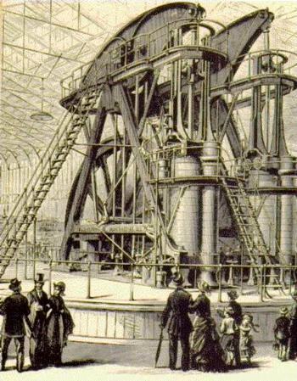
The Industrial Revolution

Slide 2
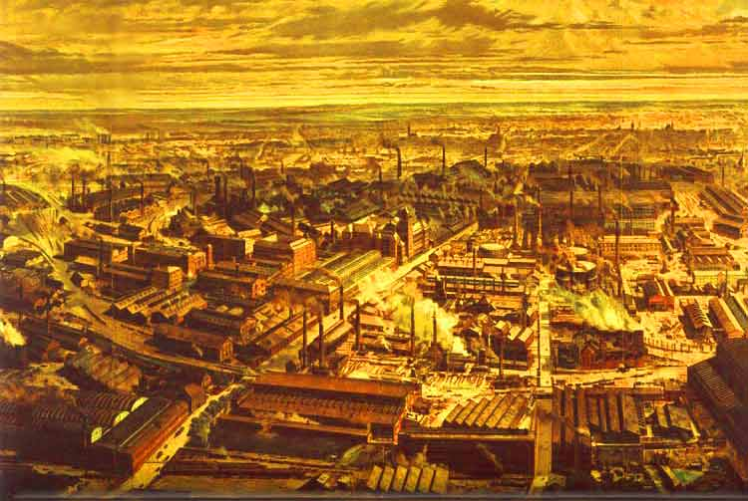
Dawn of the Industrial Age
The Industrial Revolution
  Started in Britain
  Saw a shift in simple hand tools to complex machines
  New sources of power replaced human and animal power
In 1750 most people worked the land using handmade tools
People did not know much about the world outside of their own village
By 1850 many country villages had turned into industrial towns and cities

Slide 3
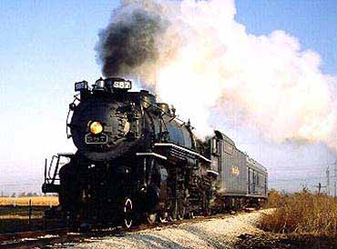
Dawn of the Industrial Age
Invention rapidly increased
  1855 – First anesthetic was used
  First sewing machine
  Antiseptic invented
  Steam Power invented – James Watt
  Steam Engine invented
  Cotton Gin invented
  Skyscrapers invented
  Steelworks invented
Industrial age led to travel by train or steamship
People could communicate through the telegraph

Slide 4
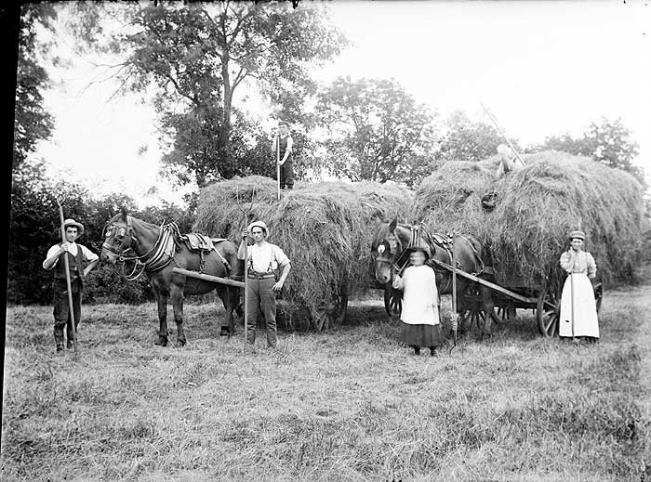
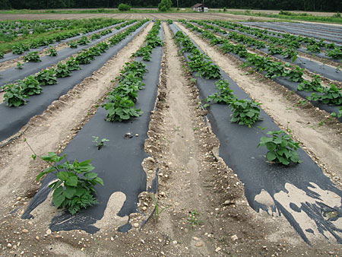
Dawn of the Industrial Age
A New Agricultural Revolution
  Created dikes
  Used fertilizer
  Studied the soil and used crop rotation
  Created the seed drill
  Industrialization required fewer workers = higher profits
  Most village farmers were put out of business
    They moved to the cities to look for work

Slide 5
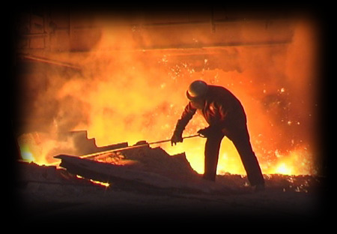
Dawn of the Industrial Age
Unprecedented growth
  Population of Britain grew from 5 to 9 million
  Population of Europe grew from 120 to 190 million
Improved energy
  Water mills
  Windmills
  Coal
Improved Iron
  Smelt Iron – separates iron from it’s ore
  Led to high quality iron

Slide 6

Britain Leads the Way
Britain is the first country to industrialize – Why?
  Resources – Large supplies of coal and iron – large working force
  New Technology – Plenty of skilled mechanics who were eager to meet growing demand for new inventions
  Economic Conditions – Britain was wealthy and looking for new ventures
  Political and Social Conditions – Stable government where taking economic chances was encouraged

Slide 7
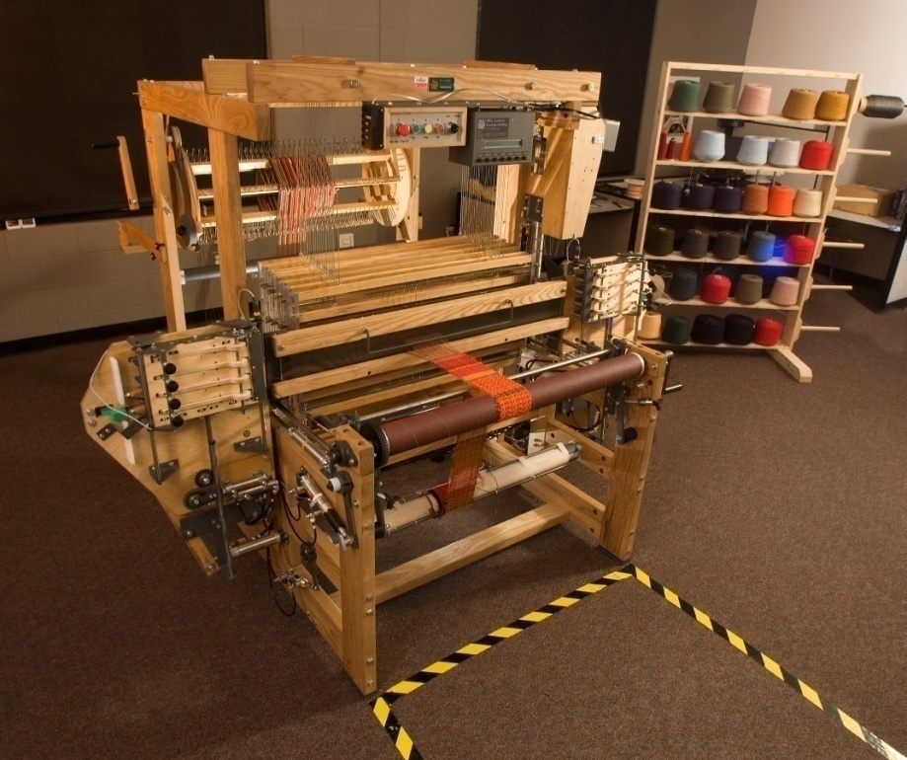
Britain Leads the Way
Changes in the Textile Industry
  Cloth from India became very popular
  Increased demand for cloth in Britain
  Spinning Jenny invented in 1764
    Increased cloth production 10 fold
  First Factories – places that brought together workers and machines to produce large quantities of goods
  More production = more money

Slide 8
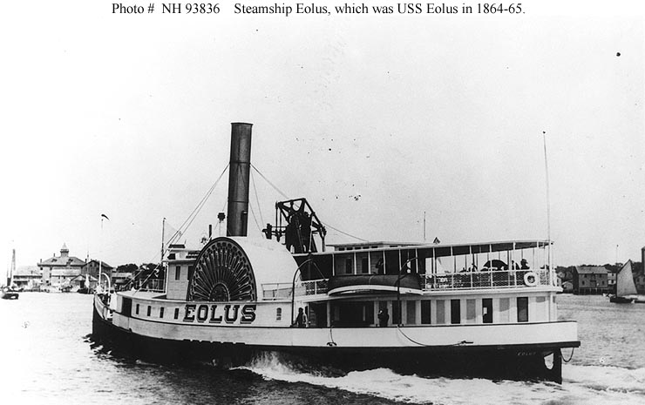
Britain Leads the Way
  Revolution in Transportation
    On Land
      Steam locomotive & railroads
      Railroads made shipping goods very easy
      Turnpikes – roads built by capitalists – charged money to use
    On Sea
      Steamboat
      Steam freighters
        Could carry 10 to 20 times the amount of cargo that a wooden ship could carry

Slide 9
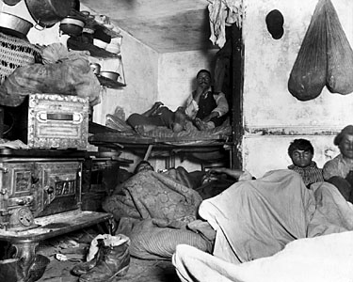
Hardships of Early Industrial Life
Urbanization – Movement of people to cities
Changes in farming, soaring population growth and increase in demand for workers led to Urbanization
Air became polluted in industrialized cities
Many workers were packed into tenements (small apartments)
Living conditions for workers were terrible

Slide 10
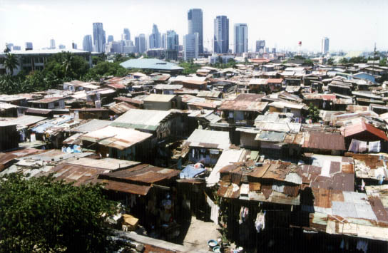
Hardships of Early Industrial Life
Tenements
  No running water
  No bathrooms or sanitation system
  No garbage areas
  Cholera spreads rapidly
  These cities become known as slums
  When was the last time we learned about human waste and garbage in the streets?
    The Black Death

Slide 11
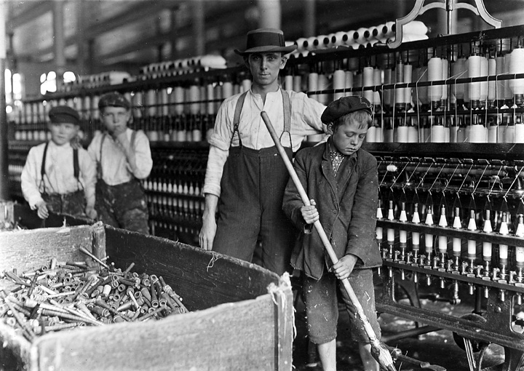
Hardships of Early Industrial Life
The Factory System
  Rigid Discipline
    12-16 hour shifts
    men, women and children
    exhaustion led to many accidents
    many lost limbs, got black lung, white lung or died
    Workers were fired if they were sick
    Then went home to feed families and deal with sickness
    Life sucked
  Women Workers
    Worked same hours and made less

Slide 12
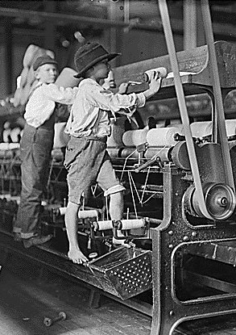
Hardships of Early Industrial Life
Child Labor
  Small fingers made it easier to work with machine parts
  Small frames allowed them to squeeze into narrow mine shafts
  Many orphans were “bought” by corporations and used for labor
You have just worked a 12 hour day at a coal mine or textile factory. In your binder write a letter to your parents describing your new job and whether or not you want to continue working.

Slide 13

Hardships of Early Industrial Life
Strikes and labor unions were outlawed
  12 killed in a protest in Manchester, England
Methodism spreads throughout the slums
  Methodists adopted sober, moral ways and stressed a personal sense of faith
New Middle Class
  Many did benefit from the Industrial revolution
    Investors, entrepreneurs and inventors

Slide 14
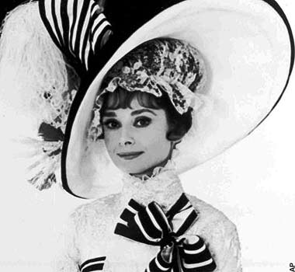
Hardships of Early Industrial Life
The New Middle Class
  Ladies were encouraged to become “ladylike”
  They took up embroidery, drawing and piano
  Ladies did not work – they hired maids
  Women educated their children
  Had little sympathy for the poor
    Middle class felt the poor were responsible for their own misery or that they were lazy and ignorant
Since Oak Park is an affluent area, what is your opinion of poor people? Below your last warm up, write whether you agree with the English Middle Class of the Industrial revolution or if you think differently.

Slide 15
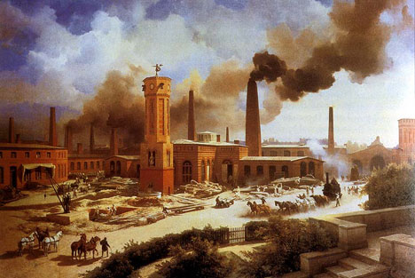
Hardships of Early Industrial Life
Many workers called for labor unions
Eventually working class men gained the right to vote
Con’s to the Industrial Revolution
  Low pay initially
  Unemployment
  Dismal working conditions
  Slums & Disease
  Social problems
Pro’s to the Industrial revolution
  Demand for mass produced goods
  More jobs were available
  Wages eventually rose
  Cost of travel fell
  Opportunities increased

Slide 16
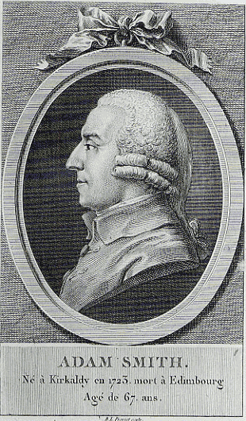
New Ways of Thinking
Successful people of the Industrial Revolution embraced Laissez-faire economics
What does this mean?
They embraced Adam Smith’s “The Wealth of Nations”
Where have we seen this before?
Thomas Malthus predicted that the economic growth would outpace the food supply
  He said that society needed checks on population such as war, disease and famine
  If not the poor would suffer
  Malthus urged families to have less children

Slide 17
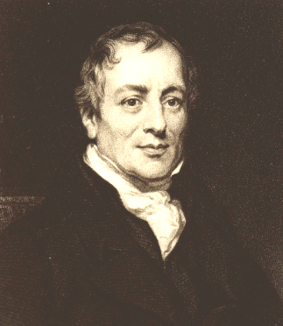
New Ways of Thinking
David Ricardo
  Argued that when wages were high people had more children and this provided more people for the work force which lowered wages and led to higher unemployment
After Malthus and Ricardo economics became known as the “dismal science”
They both opposed government help for the poor
In your binder write whether or not you think poor people in the United States should get Welfare or any other help from the government

Slide 18

New Ways of Thinking
Utilitarianism – the greatest happiness for the greatest number of people
Socialism emerges
  Socialists argued that the only way to get rid of poverty and injustice was to adopt socialism
Socialism – everyone owns and operates everything
Socialists believed in the general good nature of people
Socialists wanted to eliminate the gap between rich and poor

Slide 19
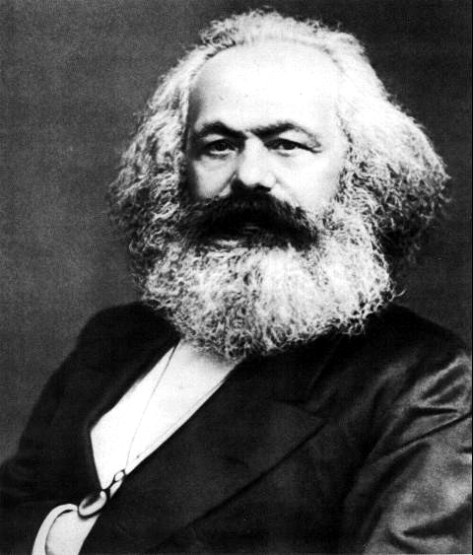
New Ways of Thinking
Karl Marx
  Agreed with the ideas of socialism and wrote “The Communist Manifesto”
  Marx hated Capitalism
  Argued that all of history can be defined by the struggle between the “haves” and “have Nots”
  “Haves” = Bourgeoisie
  “Have Nots” = Proletariat
  Marx felt that the Proletariat would eventually revolt and take over the world

Slide 20

The Industrial Revolution Spreads
Belgium follows Britain’s lead in the Industrial Revolution
Germany, France and the United States shortly follow
The United States eventually becomes the leading Industrial Power in the world
Eastern nations did not Industrialize as fast as Western nations
Russia eventually Industrializes after a long period of social and political unrest

Slide 21
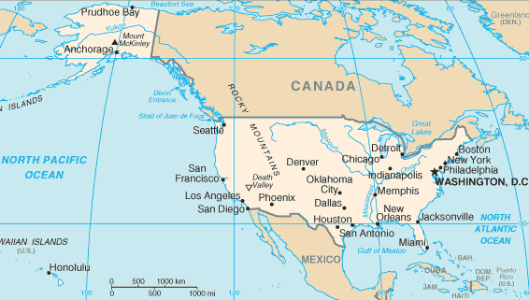

The Industrial Revolution Spreads
Western Nations become dominant
Companies began to hire scientists and researchers to make machines and products better
Most nations measured their success based on the amount of steel they outputted
Nations started to experiment with chemicals
  Alfred Nobel invents dynamite

Slide 22

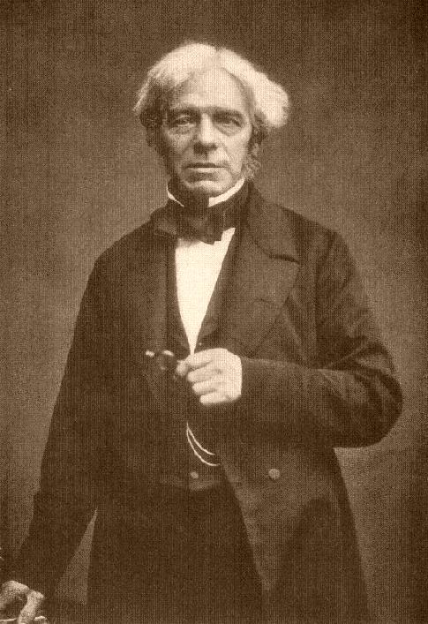
The Industrial Revolution Spreads
In the Late 1800’s electricity replaced steam as the dominant source of Industrial power
  Alessandro Volta – creates first battery
  Michael Faraday – creates first dynamo (machine that generates electricity)
  Thomas Edison – creates first light bulb
Electricity allowed factories to work after dark

Slide 23
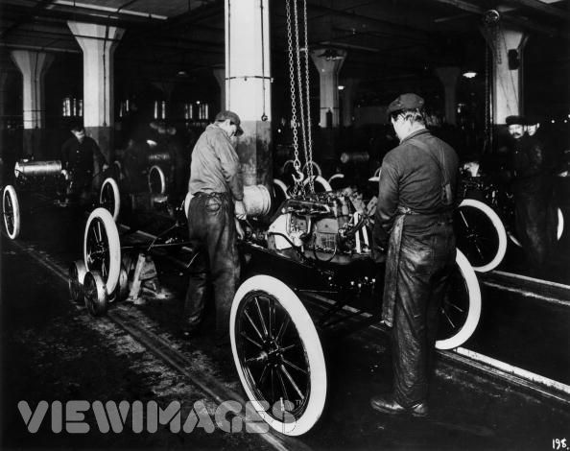
The Industrial Revolution Spreads
Companies begin to design products with interchangeable parts
  Assembly Line created
  Both of these increased production
Automobile Age begins
  Invented in Germany by Nikolaus Otto, Karl Benz and Gottlieb Daimler
  Improved upon by Henry Ford
  People laughed at these “horseless carriages”
Assembly Line Activity

Slide 24
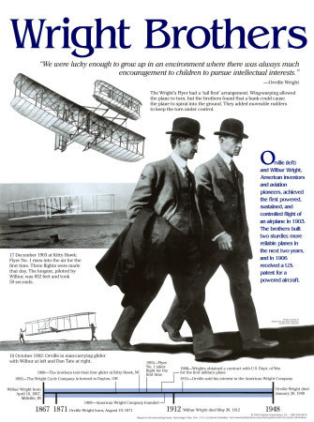
The Industrial Revolution Spreads
Conquest of the Air
  Orville and Wilbur Wright flew the “Kitty Hawk” in 1903
  Commercial flight begins in the 1920’s
Rapid Communication
  Samuel Morse invents Morse code for telegraph - 1844
  Alexander Graham Bell invents the Telephone - 1876
  Guglielmo Marconi invents the radio - 1890

Slide 25
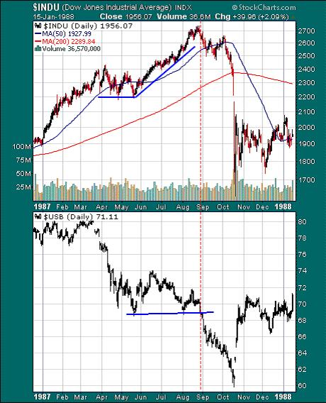
The Industrial Revolution Spreads
New Directions for Business
  Businesses began to sell stock
  Corporations begin to form
  A movement towards monopolies
    Monopolies buy everything they can and eliminate the competition
    Once the competition is gone they can raise the prices to any level they want
  Sometimes monopolies would form together to form a cartel
  Many call for regulation against monopolies and cartels
  In your binder write about your opinion of monopolies and cartels

Slide 26
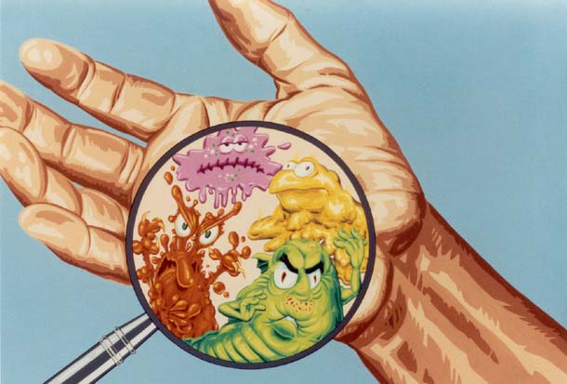
The World of Cities
Between 1800 and 1900 the world population doubles
  This is not because families were larger
  It is because the death rate decreased
    People ate better and medical advances allowed for this
  Germ Theory
    Louis Pasteur discovered the link between germs and disease
    He also created vaccines for these germs and microbes
    Created the process of pasteurization – filtering milk

Slide 27
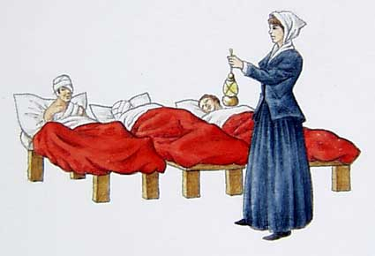

The World of Cities
Florence Nightingale
  Cleaned up hospital conditions
Urban Renewal
  Repairing the poor areas of cities
  Sidewalks, Sewers, Street Lights, Police & Fire Departments, Clean Water
  Slums continued to exist in the poorest outskirts of cities
Labor Unions
  Fought for workers rights
  Helped increase the standard of living

Slide 28
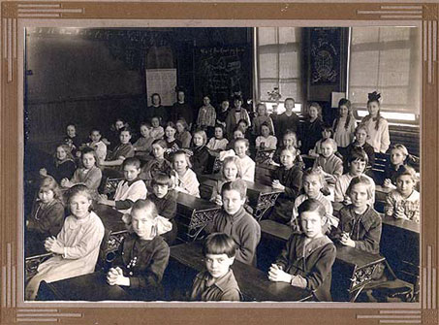
Changing Attitudes and Values
A new social order
  For the first time in history the upper class included the self made rich
  Young people had more of a choice who they married
  The rights of women were promoted – woman’s suffrage
  Public education is promoted
  Higher education is promoted
  Charles Darwin – “The Origin of Species” – evolution
  Social Darwinism – survival of the fittest amongst people
    Helped encourage racism

